Slide 1
HTM Insurance Company
Virtual Board Meeting – January 14, 2021

Slide 2
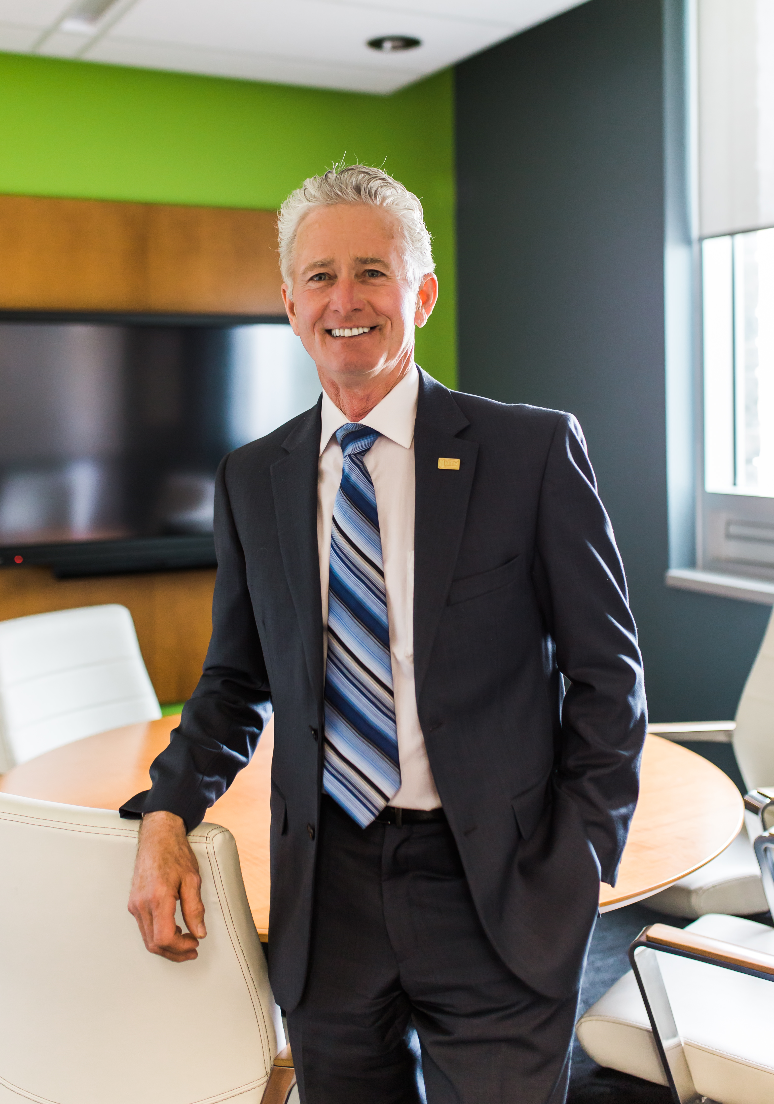
Welcome & opening remarks
Notes:
Allan’s opening remarks

Slide 3
declaration
Conflict of Interest
Notes:
ALLAN: I would ask anyone if you have any conflict of interest.

Slide 4
mission
“To protect your future as if it’s our own”
Notes:
ALLAN: Although we haven’t officially launched our new mission, vision and core values, we are going to start using them at today’s first virtual meeting. As we read these statements, I think you will find they will guide us in many of our decisions today.
ALLAN: I’m going to read the vision “To …..”

Slide 5
vision
“Our family striving to provide you with peace of mind by protecting your tomorrows today”
Notes:
ALLAN: I am going to call on our Vice-chair Dave Ruterford to say the vision statement.
DAVE: My pleasure Allan ….. “Our family ……”

Slide 6
summary agenda
Approval of agenda
Consent Agenda Items
Annual Meeting
Statistics & Financial
Budget
Donations
Pandemic Risk
Notes:
ALLAN: These items were provided prior to the board meeting and form the consent agenda package.
ALLAN: I will now move to the motion.

Slide 7
Motion
“That the Agenda by adopted as distributed.”
Notes:
ALLAN: We have a motion by Dave, seconded by Nancy, that the agenda be adopted as distributed.
ALLAN: Is there any discussion on the agenda.
ALLAN: Could we have a show of those in favour by raising your virtual hand.
ALLAN: Since this is the first motion, we will take a moment and help anyone who may have an issue with the technology.
ALLAN: Seeing at least five virtual hands raised, I declared the motion passed.

Slide 8
Consent agenda documents
OMIA Updates
Collectivfide Updates
Management Discussion & Analysis
Board Meeting Survey
Company 789 Restructuring
Management Reports
Notes:
ALLAN: These items were provided prior to the board meeting and form the consent agenda package.
ALLAN: I will now move to the motion.

Slide 9
Motion
“
To accept the Consent Agenda items as distributed.”
Notes:
ALLAN: We have a motion by Bruce, seconded by Nancy, to accept the consent agenda items as distributed.
ALLAN: Is there any discussion on the motion.
ALLAN: Could we have a show of those in favour by raising your virtual hand.
ALLAN: Seeing at least five virtual hands raised, I declared the motion passed.

Slide 10
Annual meeting
conversation

Slide 11
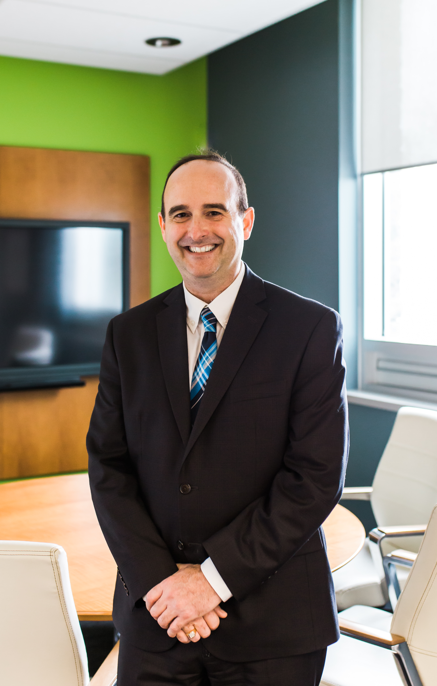
President’s report
Statistics and financial

Slide 12
To February 28, 2021
Premiums Written by Policy Class

Slide 13
To February 28, 2021
Policy
Count

Slide 14
Month of February 2021
New
Claims
Count

Slide 15
Month of February 2021
Claims Incurred by Policy Class

Slide 16
To February 28, 2021
New
Claims
Count

Slide 17
To February 28, 2021
Claims Incurred by Policy Class

Slide 18
To February 28, 2021
Performance by Policy Class

Slide 19
As at February 28, 2021
Balance Sheet

Slide 20
To February 28, 2021
Income Statement

Slide 21
To February 28, 2021
Income Statement

Slide 22
Premiums | HTM | ALL MUTUALS
Current | 34,024,031 | 926,950,000
Prior | 31,404,648 | 860,910,000
Growth | 8.3% | 7.7%
All Mutuals Comparison for 2020
Excludes Commonwell

Slide 23
Policy Count | HTM | ALL MUTUALS
Current | 20,497 | 570,703
Prior | 20,110 | 584,566
Growth | 1.9% | (2.4%)
All Mutuals Comparison for 2020
Excludes Commonwell

Slide 24
Claims Incurred | HTM | ALL MUTUALS
Current | 17,507,141 | 444,900,000
Prior | 16,751,593 | 483,300,000
Growth | 4.5% | (7.9%)
All Mutuals Comparison for 2020
Excludes Commonwell

Slide 25
Claims Count | HTM | ALL MUTUALS
Current | 739 | 27,828
Prior | 855 | 36,225
Growth | (13.6%) | (23.2%)
All Mutuals Comparison for 2020
Excludes Commonwell

Slide 26
Loss Ratio | HTM | ALL MUTUALS
Current | 53.3% | 49.6%
Prior | 56.3% | 59.4%
Growth | (5.3%) | (16.5%)
All Mutuals Comparison for 2020
Excludes Commonwell

Slide 27
budget
review

Slide 28
Display

Slide 29
donations
discussion

Slide 30
Pandemic risk
Community room, board meeting criteria, vacinations

Slide 31
Other business
Additional topics

Slide 32
Motion
“That the meeting be adjourned”
In-camera to follow…..
Notes:
ALLAN: We have a motion by Dave, seconded by Nancy, that the agenda be adopted as distributed.
ALLAN: Is there any discussion on the agenda.
ALLAN: Could we have a show of those in favour by raising your virtual hand.
ALLAN: Since this is the first motion, we will take a moment and help anyone who may have an issue with the technology.
ALLAN: Seeing at least five virtual hands raised, I declared the motion passed.

Slide 33
In-camera

Slide 34
Thank You
February 2021 board

