Slide 1
HTM Insurance Company
Board Meeting – November 10, 2020

Slide 2
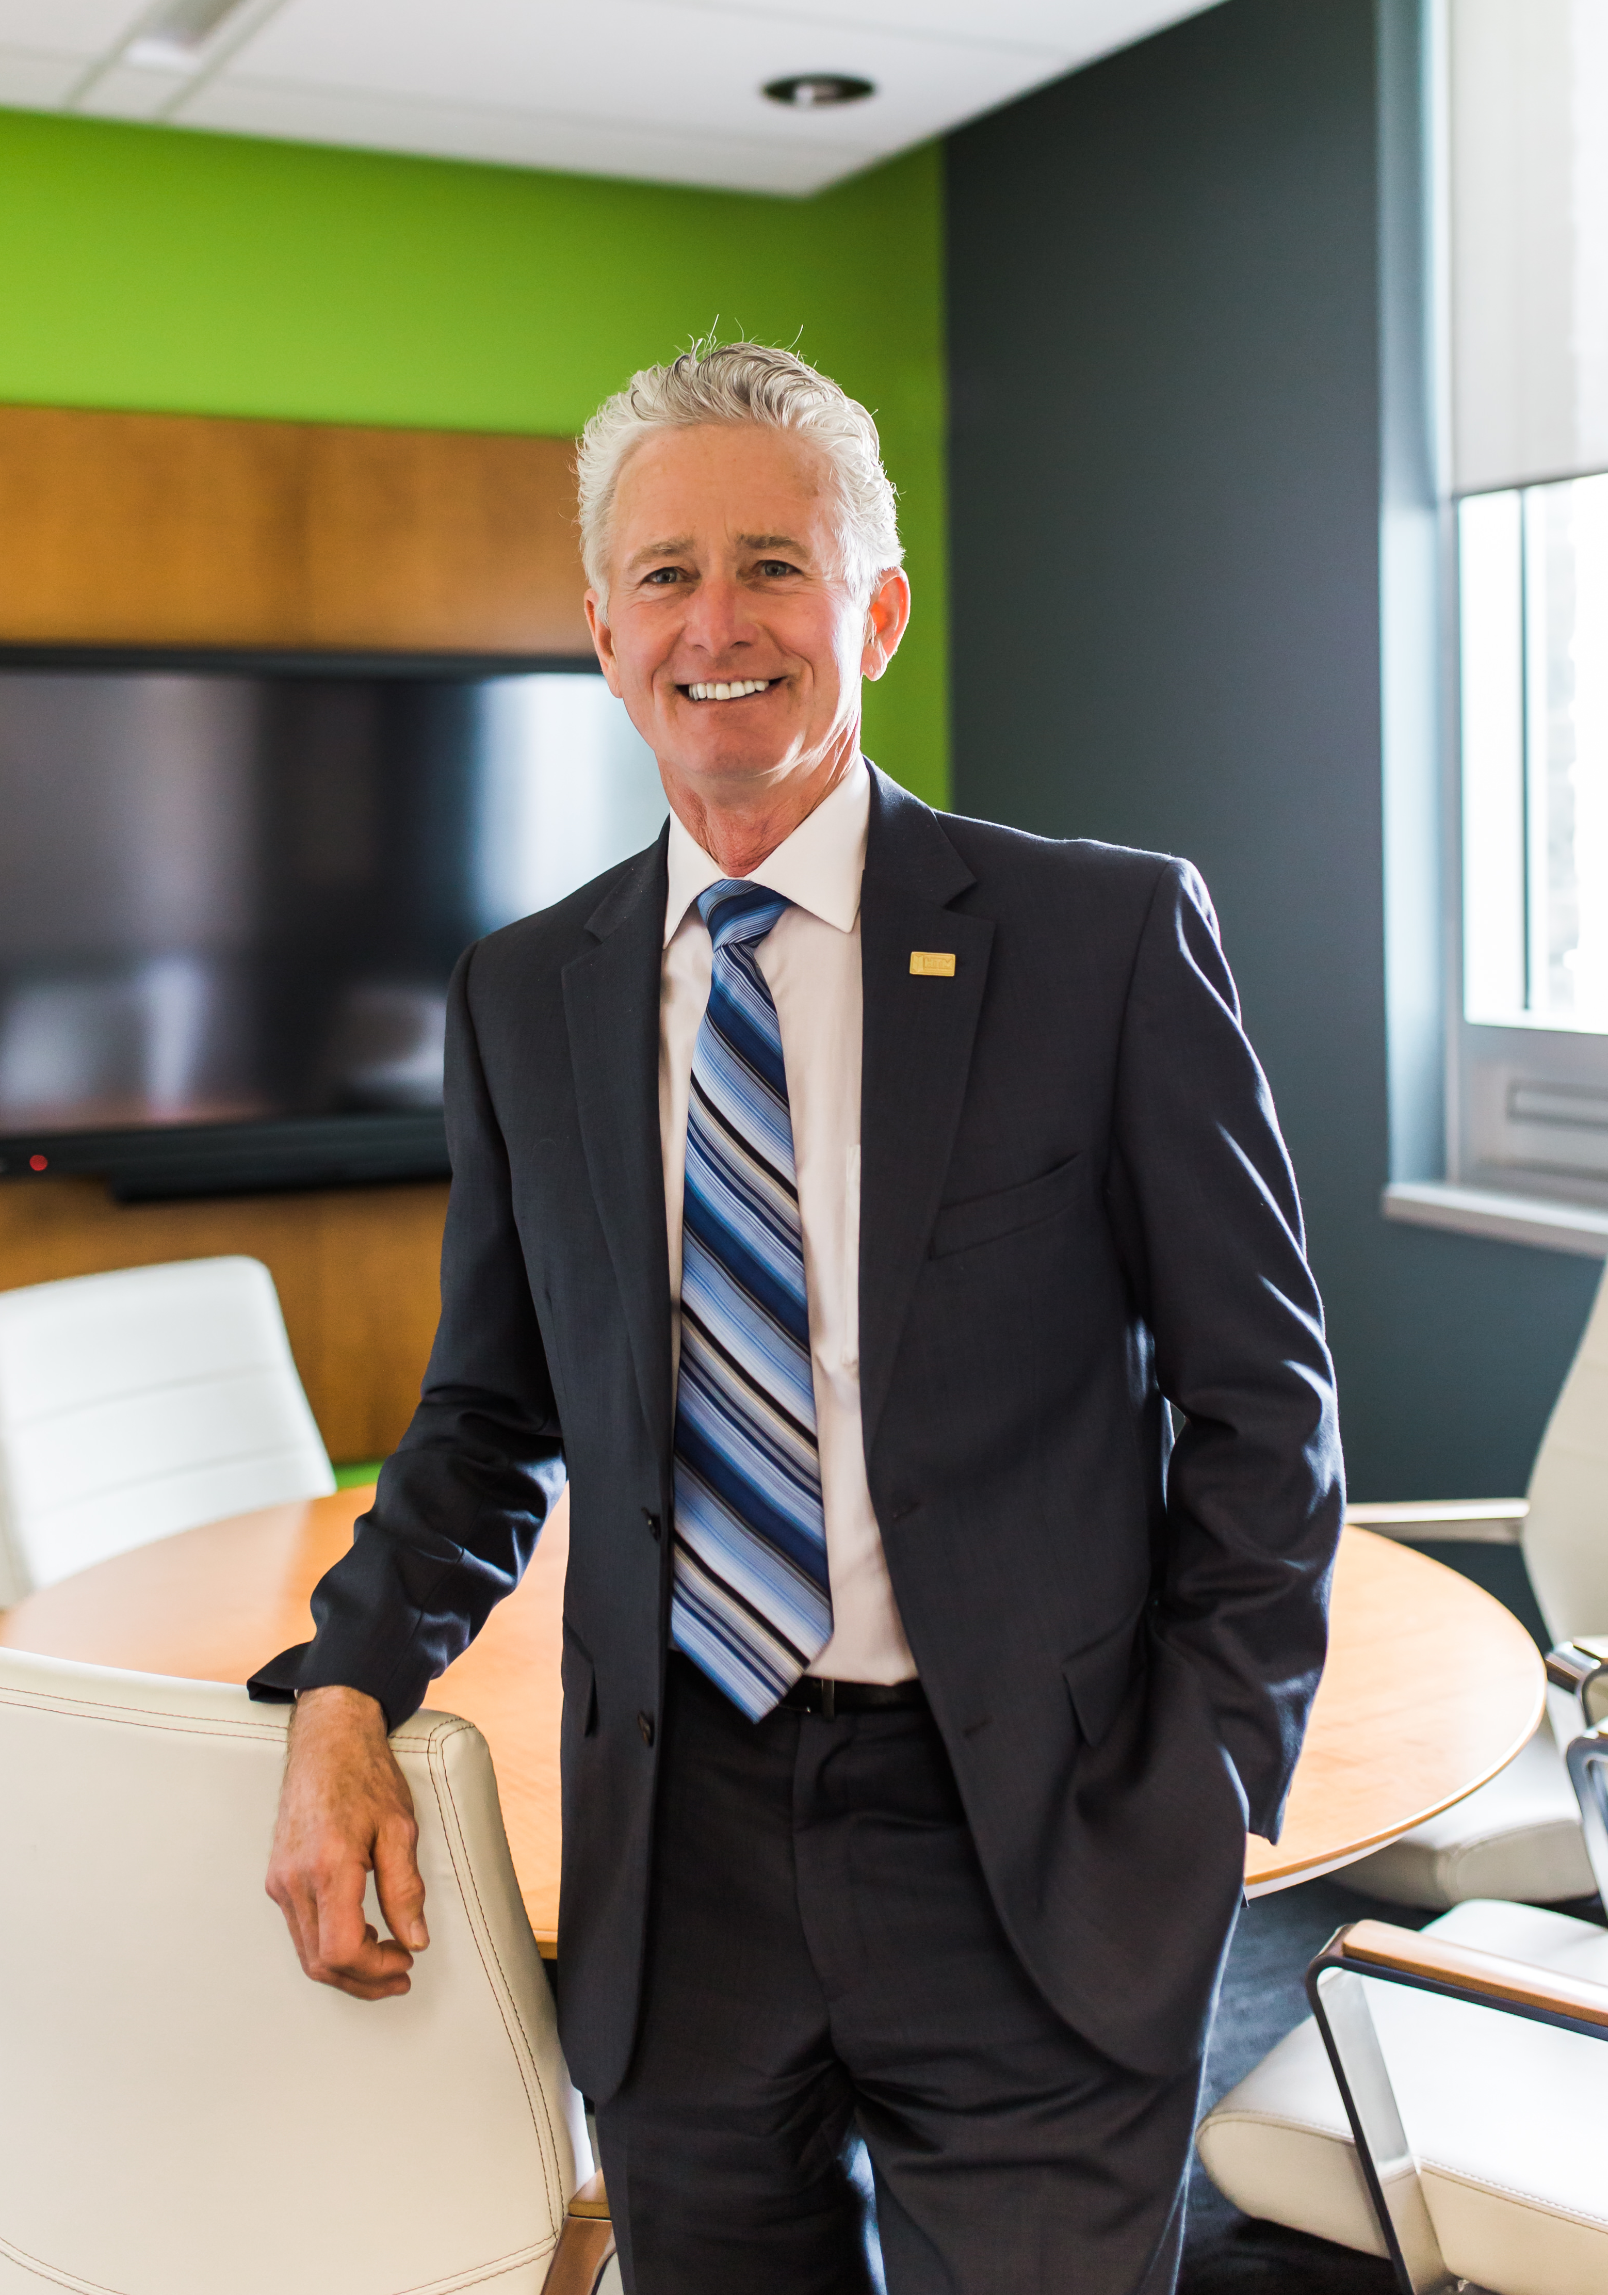
Welcome & opening remarks
Notes:
Allan’s opening remarks

Slide 3
declaration
Conflict of Interest
Notes:
ALLAN: I would ask anyone if you have any conflict of interest.

Slide 4
mission
“To protect your future as if it’s our own”
Notes:
ALLAN: I’m going to read the vision “To …..”

Slide 5
vision
“Our family striving to provide you with peace of mind by protecting your tomorrows today”
Notes:
ALLAN….. “Our family ……”

Slide 6
agenda
Welcome and Call to Order
Consent agenda
Management report including September financials
Pearson Proposal
Group E
Budget
Donations
Other Business
Virtual AGM
Notes:
Allan: On the screen in front of you we have had the agenda. We have had received this agenda last Thursday so I am going to move on to the motion.

Slide 7
Motion
“That the Agenda by adopted as distributed.”
Moved by
Seconded by
Notes:
ALLAN: We have a motion by “ “, seconded by “ “, that the agenda be adopted as distributed.
ALLAN: Is there any discussion on the agenda.
ALLAN: Could we have a show of those in favour by raising your virtual hand.
ALLAN: Since this is the first motion, we will take a moment and help anyone who may have an issue with the technology.
ALLAN: Seeing at least five virtual hands raised, I declared the motion passed.

Slide 8
Consent agenda documents
Collectivfide Press Release
FMGF Update AGM Notice
December Board Meeting Minutes
January Board Meeting Minutes
Distribution Lead Report
VP Claims Report
VP Loss Prevention Report
VP Underwriting Report
President’s Report
OMIA Pension
Notes:
ALLAN: These items were provided prior to the board meeting and form the consent agenda package.
ALLAN: I will now move to the motion.

Slide 9
Motion
“
To accept the Consent Agenda items as distributed.”
Moved by
Seconded by
Notes:
ALLAN: We have a motion by “ “, seconded by “ “, to accept the consent agenda items as distributed.
ALLAN: Is there any discussion on the motion.
ALLAN: Could we have a show of those in favour by raising your virtual hand.
ALLAN: Seeing at least five virtual hands raised, I declared the motion passed.

Slide 10
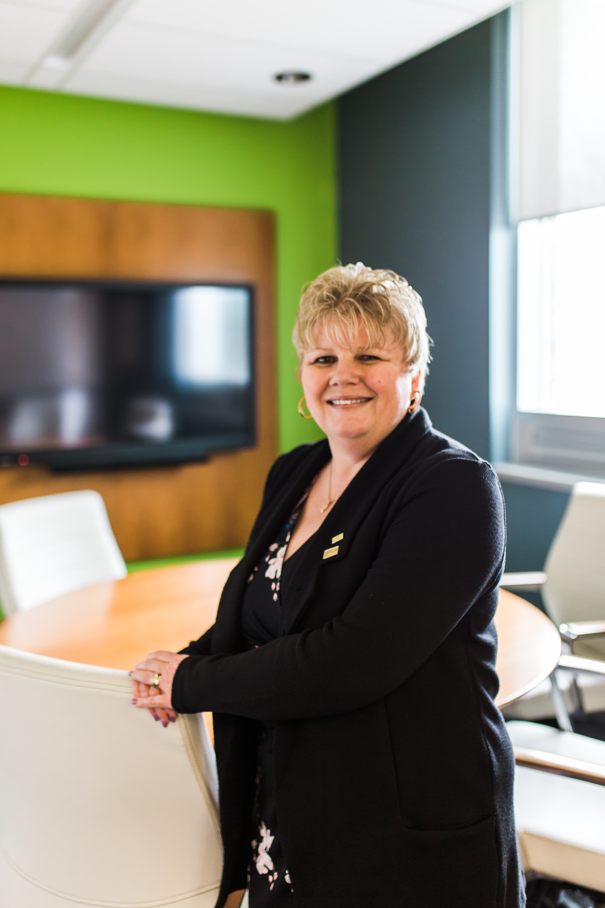
Compliance officer
Update

Slide 11
update
Annual Meeting Preparation
Document Retention Project
Complaint Reporting
Committee Meetings
Notes:
I have been working on the preparation for the AGM along with the team put together to host our first virtual AGM. The new role of Compliance Officer started in January. I am slowing reducing my time in underwriting as others start to train to take over some of my responsibilities. This will be a process that takes place over the next few months. I am hoping to start working on a updating some of our current documents and develop a few others. I would like to develop a procedure that shows document retention time frames. This will help us to stay on schedule for shredding of older documents. I will be setting up a monthly schedule to confirm if any complaints have been received to the company that are required to be reported to FSRA. We usually have very few of these to report annually. I have started a Compliance calendar to hopefully be a guide by month for the future.

Slide 12
update
Compliance Activities
Posted notices of Annual General Meeting
By-Law Changes
Conduct Review Questionnaires
Leadership Covenant
Governance Policy Review
Committee Meetings
Notes:
We have a by law change at this years AGM. This has required some discussion with Steve Grant on the publication of the change in the notice of the annual meeting. First publication to notify of the election of directors was published Jan14th in both Peterborough and Northumberland. The Notice of AGM and Special Meeting for By law change was published February 11 & 18th.
Conduct Review Questionnaires have been sent out for signing an updating for the year 2021. Also, the leadership covenant has been sent out for signatures. During the January board meeting Alec reviewed a few governance documents. Alec and I have been working on getting these updated. I have attended committee meetings with the Nominating Committee and the Audit Committee. The Director Introductory and Full Packages have been updated and are ready for the Nominating Committee to use. As we proceed forward this month the first priority is to continue with the AGM planning and testing the Zoom technology. I am looking forward to building and learning my new role.

Slide 13
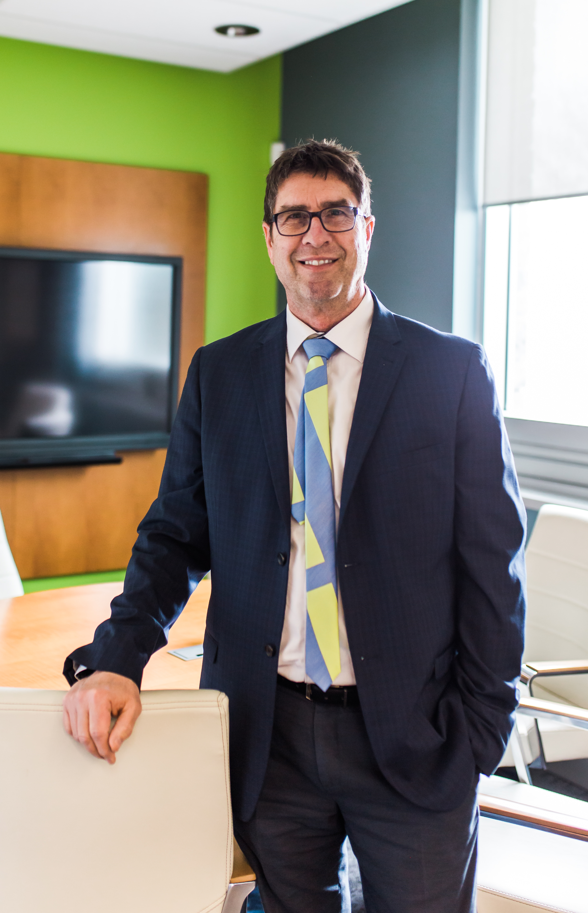
VP claims report
Update To Dec 31 for stats

Slide 14
update
Dept. Staff down two – Andrea & Aimee
Interview & selection stage for Claims Admin. Just posted for Claims Adjuster
CoVid personal protection protocols
HR Management Project underway
Notes:
HR – Alec Project Sponsor – Steve Project Leader – Heather External Consultant – Donna Internal Collaborator
Two Zoom meetings
Heather compiled Functional Areas Review spreadsheet which compares our processes against the 14 core functions of a comprehensive Human Resource Management Program
The gap analysis will inform project planning. The project is substantial and we will need to prioritize areas for attention.

Slide 15
Update
751 claims – down 12% over 2019
14 claims > $200,000 for $8.8M – including $2.8M DW fire
November CAT for $2.2M
$1.9M positive development on prior year claims
$17.5M Gross Claims Incurred – up $755,000 from 2019

Slide 16
To Dec 31, 2020
Claim’s Activity for the Period
Notes:
Gross Claims Incurred added losses of $5,586,000 in the final Quarter to close the year at $17,507,142.
The period included three dwelling fires and a a CAT level windstorm which pushed claim count in the Q to 243.
Results were supported by negative incurred of $1,483,000 on prior year claims.

Slide 17
To Dec 31, 2020
Claim Summary
Notes:
This table breaks down the Gross Claim Incurred by Claim Class, with comparison to the YTD New Claim incurred.
Favourably, positive development on prior years claims of $1,927,508 mitigated the actual cost of current year claims.

Slide 18
To Dec 31, 2020
OUTSTANDING CLAIMS
Notes:
We closed the year with 393 open files carrying aggregate reserves of $20,180,000.
The distribution by year of occurrence is typical, with 58% of reserve held against current year claims, and fully 83% on files 2018 or newer.

Slide 19
To Dec 31, 2020
Claim by Loss Type
Notes:
This slide breaks down the YTD Gross Incurred to kind of loss categories in auto, liability and all property.
Auto GCI is 26% lower than 2019
Liability is 55% higher, however on smaller amounts.
The Property numbers show the volatility of weather on results. While water losses were substantially less, wind, led by the November 15 event, were – pardon the pun – “through the roof” – in comparison to 2019.

Slide 20
Reported Claims
Gross Claims Incurred
Time | # | Total
Day 1 | 54 | 54
Day 2 | 5 | 59
Day 3 | 2 | 61
Day 4 | 5 | 66
Day 5 | 6 | 72
Day 6 | 0 | 72
Day 7 | 0 | 72
2nd Week | 8 | 80
3rd Week | 5 | 85
4th Week | 1 | 86
Over 4 | 1 | 87
$2,202,013
Reinsurance Recovery
$627,013
Outstanding Reserves @ February 6, 2021
November CAT Loss
$1,332,515
Largest Individual Claim
$306,200
Average Claim Size
$25,310
Notes:
This slide provides details of the CAT loss scope and cost.
The GCI is a moving target pending file closing, however has settled in at ~ $2.2 M
The CAT retention is three times Property’s $525,000, which, would produces a $627,000 recovery on current numbers.
The largest of the 87 claims drew opening reserves of $306,000
Average claim cost is high for wind at $25,310

Slide 21
To Dec 31, 2020
Claim Expenses YTD
Notes:
Claim expenses for the year totaled $846,121, down marginally from 2019.
Independent Adjuster costs were up $51,000, reflecting the greater reliance on the external resource during the ongoing pandemic.
Other expense categories were comparable or below last years numbers.

Slide 22
To Dec 31, 2020
Notes:
Auto added just $866,084 in period losses to close out the year at $3,541,265, which is $1.4M below plan and $1.3M improved over 2019.
The line booked 321 claims in the year vs. 404 in the plan

Slide 23
To Dec 31, 2020
Notes:
Commercial was never going to replicate 2019 results, but it did close well below plan.
The Gross Claims Incurred of $919,468 is $203,369 less than plan
Claim volume was predictably low, at 38 for the year, compared to 44 in the budget.

Slide 24
To Dec 31, 2020
Notes:
Farm lost significant ground in the 4th Q, mostly due to November losses.
Farm took on a substantial portion of the CAT claims to post an Incurred for that month alone of $1,371,124.
Nonetheless, the line closed the year with gross losses of $3,297,274 - $903,000 under plan.

Slide 25
To Dec 31, 2020
Notes:
The Residential class continued its upward trajectory that began in September, only tailing off in the last month.
The line added $6.3M in losses over the last 4 months to close the year at $9,749,135 - $2,149,135 above plan and $1.3M over 2019.
The category booked 233 claims in 2020.

Slide 26
To Dec 31, 2020
Notes:
The monthly stats are a tale of two stories. Opening the year with five strong consecutive months, opposed by a much less stellar final four.

Slide 27
To Dec 31, 2020
Notes:
We posted a Gross Claims Incurred for the year of $17,507,142, which despite the challenges of severity and the CAT, managed to close at $792,858 below plan, if still, $755,549 over 2019.

Slide 28
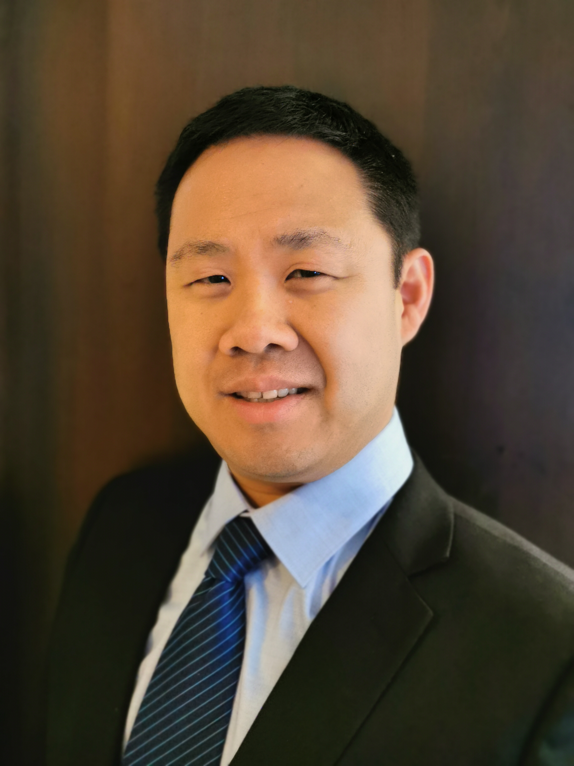
VP underwriting report
Update to September 30 for stats

Slide 29
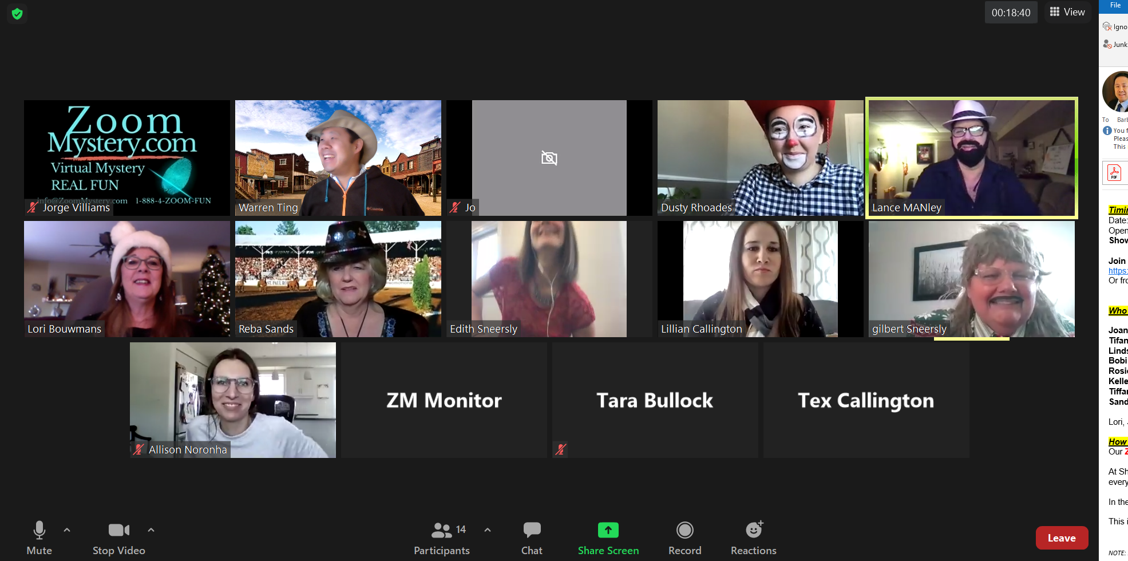
Assessing risks and murders…

Slide 30
update
Maximum of 6 team members in the department on a given day
Cognition+ Farm testing in full swing
Weekly email updates to the department
Formulation of a “Covid” discount for selected commercial policies
New Underwriting Admin: Kay Farrell-Lang
Promotions:
Lindsay Reinert – Personal Lines Underwriter
Jade Hind – Underwriting Renewal Analyst

Slide 31
update
Service of backlog is all cleared, INCLUDING inspections!
Underwriters attending OMIA Property and Automobile Roundtables
Congratulations to our new Insurance Institute grads!
NEW CIP GRADUATE: Tifanny Gibbs
NEW COMMERCIAL INSURANCE CERTIFICATE: Barb Dinnage

Slide 32
To December 31, 2020
Policies In-force by Policy Class
Policies in Force
Last Year
Notes:
For 2020, we saw an increase in PIF count by 3.5% to 20,501 PIF
Auto and Property showed most PIF growth at almost the same rate which is a good sign in that HTM is insuring total policy packages with both auto and home at 3.8% and 4.0% respectfully
Commercial and Farm has shown nominal PIF growth (Commercial +2.1% and Farm +1.8%)

Slide 33
Fourth Quarter 2020
Premiums Written by Policy Class
Premiums Written
Last Year
TREND
BETTER
NEUTRAL
WORSE
Notes:
In the 4th quarter as we are fully in pandemic mode, we grew in premiums written at a rate of 7.0% which is an increase from Q3 at 5.9%
Much of this premium growth are from rate increases and increases in TIV values of residential property

Slide 34
To December 31, 2020
Premiums Written by Policy Class
Premiums Written YTD
Last Year
Notes:
Written premiums grew in every line for 2020. Most growth was in the Commercial line of business @ 12.0%
Residential grew by 9.3%
Auto grew by 6.9%
Farm grew by 6.4%
In 2019, we grew by 11.6% so for a pandemic year, growing by 8.3% is a healthy growth rate.

Slide 35
Fourth Quarter 2020
New
Policy
Count
TREND
PRIOR YR
Notes:
After stellar growth in 2019, it would have been tough for 2020 to match 2019 new policy counts, especially with being in the pandemic.
Every line of business showed a decrease in new business policy growth except Farm in the 4th quarter. Farm grew by 12.5%
Commercial continued to show the most amount of decrease with businesses not opening during the pandemic period @ 27.4% which is improved from Q3 (-36.9%)
Auto showed a decrease of -20.3% and Residential showed a decrease of -16.7%
- Actual total numbers of PIF Fourth Quarter 2020 is 569 with a breakdown as follows: Auto – 163; Commercial – 62; Farm – 54; Residential - 290

Slide 36
To December 31, 2020
New
Policy
Count
YTD
PRIOR YR
Notes:
For 2020, you’re seeing the same trends of decrease in new business policy count in every line of business except Farm.
Every line of business showed a decrease in new business policy growth with Farm showing the least amount of decrease at -11.6%
Commercial showed the most amount of decrease with businesses not opening during the pandemic period (-27.5%)
Auto showed a decrease of -25.3% and Residential showed a decrease of -16.9%
Actual total numbers of PIF for 2020 is 2,189 with a breakdown as follows: Auto – 668; Commercial – 258; Farm – 153; Residential – 1,110
- In 2019, HTM wrote 2,759 new PIF, -20.7% less in 2020

Slide 37
Fourth Quarter 2020
Cancelled
Policy
Count
TREND
PRIOR YR
Notes:
In the cancellation front, we have seen an increase in cancellations in all lines of business. The largest line of cancellations Commercial as much of these cancellations are businesses shutting down due to the pandemic.
- Actual cancellation numbers of PIF for the 4th quarter is 520 with a breakdown as follows: Auto – 126; Commercial – 76; Farm – 53; Residential – 265
- For comparison, the cancellation number for 2019 4th quarter was 431

Slide 38
To December 31, 2020
Cancelled
Policy
Count
YTD
PRIOR YR
Notes:
For 2020, we have seen the same trends as the quarter breakdowns. The two largest lines of cancellations were in auto and commercial. Many insureds cancelled their auto insurance policy as there weren’t using their vehicle for commuting and with commercial, much of these cancellations are businesses shutting down due to the pandemic.
- Actual cancellation numbers of PIF for 2020 is 1,767 (2019 was 1,498) with a breakdown as follows: Auto – 500; Commercial – 280; Farm – 128; Residential - 859

Slide 39
As at December 31, 2020
Retention
Rate
Notes:
With the increase of cancellations, it is normal to see that our retention rate as also decreased. Our current 2020 retention rate is 92.9% which is a decrease of 1.0% from 2019. This retention rate for 2020, in light of all the cancellations is still very strong for HTM. Much of this is kudos to our underwriting team in being able to service and manage our policies with all the challenges from the pandemic. Any decrease in servicing to brokers will generally lead to percentage point decreases in retention but we have gotten through these challenging times relatively unhurt.
The retention for 2020 actually got better in Q4 as Q3 showed a retention of 92.3%.
- The one line of business that has suffered the most is commercial. The 2020 retention for commercial is at 90% which is still high in insurance industry standards but low in HTM standards. Auto, Farm and Residential has maintained strong retention numbers at 92%, 93% and 96% respectively.

Slide 40
To December 31, 2020

Slide 41
To September 30, 2020

Slide 42
To December 31, 2020
Performance by Major Usage
YTD
Top 10 by Premium Written
Notes:
These are HTM’s most written line of business in 2020. We have two lines of business in which the loss ratio is in the red at this point. When your largest book of business is running at just under 60% L/R it will reflect positively in the your underwriting loss ratio result. This number was in the 40s after Q3 but has since increased to 59.6% as a result of large losses in Q4.
- These numbers don’t include the auto line of business but for your information, DWP is $8,414,775 and running a loss ratio of 43.1%

Slide 43
Fourth Quarter 2020
Performance by Policy Class
Notes:
As per the claims presentation, we had some large claims reported during the quarter which increased the residential loss ratio to 133.6%
All the other lines are showing great results in the Fourth Quarter with Auto at 41.1%, Commercial at 19.2%
Farm deteriorated in Q4 at 88.3%

Slide 44
To December 31, 2020
Performance by Policy Class
YTD
Notes:
The key to this graph is that the green line which shows 2020 as compared to the prior period and the 3 year period is close to or below prior and our 3 year history.
In 2020, our loss ratios are: Auto @ 43.1%; Commercial 22.7%; Residential 78.4%; Farm 40.8%

Slide 45
On the horizon
Cognition+ Farm/Commercial “Alpha” testing
Service and Quality auditing of underwriting files
Training of recently promoted team members
Periodic Underwriting Bulletins to brokers/agents
HTM training videos to be launched shortly
Water Product re-rating project to be launched Q2
Continued emphasis of “return to profitability”

Slide 46
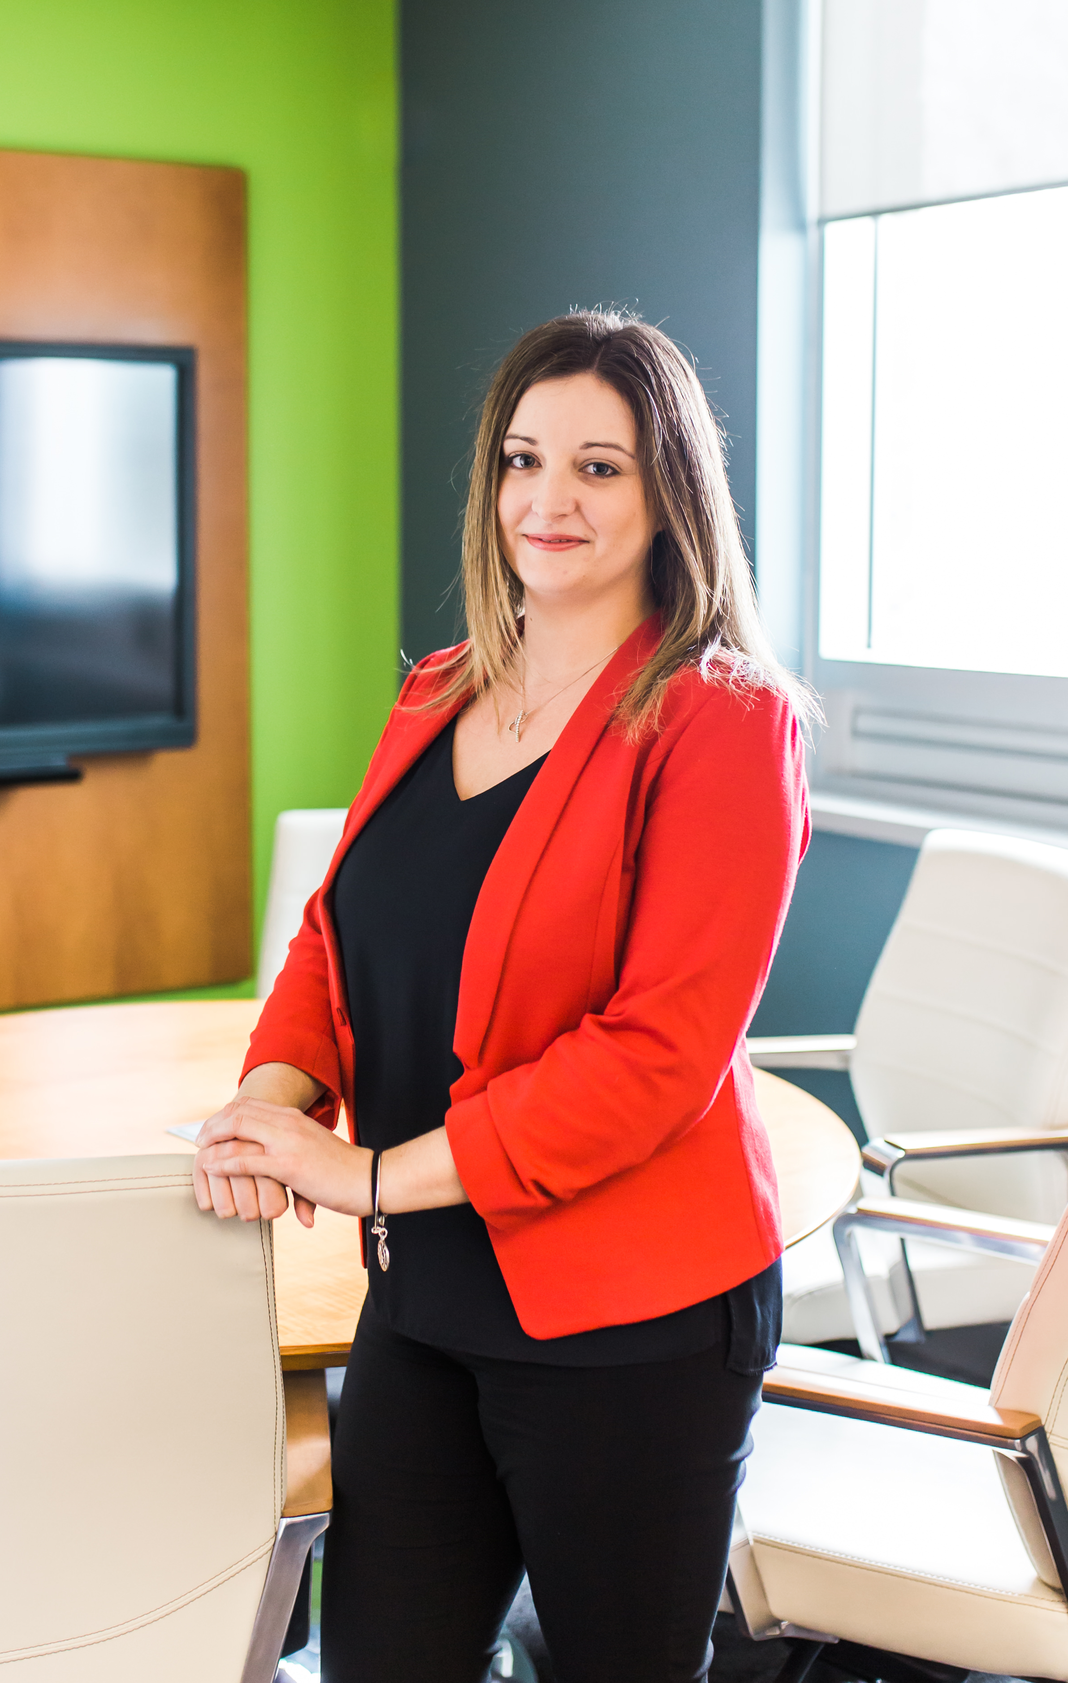
distribution lead report
Update to December 31 for stats

Slide 47
update
Agents Update
Cameron working out of Pearsons, Karen and Scott rotating between office and home
CIP Courses and Seminars
Quote and cancellation tracking
Consumer Portal Testing
Broker Update
Yearend Zoom Meetings to begin in 2021
Touchpoints by phone, email, or video call
Notes:
I continue to have touchpoints with the agents bi-weekly. Cameron is working full time out of the Pearson Insurance office, while Karen and Scott are rotating between the office and home. We have discussed protocol for visiting clients, that the visit will be outside as much as possible and if they are within 6 feet of someone they must wear a mask.
I have sent out third quarter reports to the brokers and contacted each of them, whether by phone, email, or video call to discuss their year and what they are seeing in the marketplace.

Slide 48
Fourth Quarter 2020
12
Number
of Broker Meetings & Training
Notes:
Until the end of September, I had 5 broker meetings scheduled. This number does not include phone calls or emails sent back and forth between myself and brokers. We had to postpone the farm training that we were planning on Bill Dorland's Farm. I don’t think we will be able to complete this in person in 2020. There are a few brokers that would benefit from presentations about our product offerings, so I will be starting to look into setting that up virtually in the next few months.

Slide 49
Fourth Quarter 2020
Broker/Agent | Budget | Used to Date
Allen Insurance | $4,653 | $3000
Canada Brokerlink | $5,511 | $5160
Darling Insurance | $2,803 | Donated
Elliott Insurance | $3,325 | $3325
McGlennon Insurance | $1,256 | $1256
RJ Brown | $2,874 | Donated
DG Smith | $1,028 | Donated $500
Roughley | $1,009
Bulger & Gray | $1,811 | Donated
James Gordon | $3,113 | $3,113
Pearson Insurance | $2,251 | Donated $1,500
Newman | $7,843 | $592
HUB Insurance | $1,463
Vasey Insurance | $1,899 | $1,899
Bradley Brothers | $1,652 | $1652
Taylor Forder | $2,886 | $2,886
Brown and Brethour | $1,252 | Donated
Petley-Insurance | $1,612 | Donated
WB White | $1,161
Marketing Budget
2020
Notes:
This chart illustrates the usage of our marketing program for the brokers. In 2020 we allotted $49,402 in total for the brokers to use on co-operative marketing with HTM. Once the pandemic began, we also opened this up to allow for the brokers to donate to charities within our communities. Six brokers have taken advantage of contributing within their communities, and four others have use their funds to advertise. Nine have not used any of their money to date.

Slide 50
Fourth Quarter 2020
Top 5 New Policy Counts
Notes:
For the first three quarter of 2020, the top 5 brokers with the highest new policy count are shown in this slide. Newman Insurance leading the way with 338 policies, which is 83 less than 2019. Allen Insurance has 318 new policies, 38 less than 2019. Elliott Insurance with 107 policies, 4 less than last year. Vasey Insurance with 102 policies, 112 under last years number and Canada Brokerlink – Cobourg Office with 88 new policies., 10 less than last year at this time.
Last year’s third quarter included Gunter Insurance with 142, due to the AVIVA rollover, as well as Darling Insurance who had 107 new policies last year, compared to 81 policies this year.

Slide 51
Fourth Quarter 2020
Bottom 5 New Policy Counts
Notes:
The five brokers with the lowest new policy count include Insurance Specialty Group, a part of Sentinel with 3 new policies, Beyond Insurance with one new policy, WB White Insurance, Lindsay with one new policy, Bardeau Insurance with one as well as Brokerlink, Norwood with one new policy.

Slide 52
Fourth Quarter 2020
Lower
Loss
Ratios
Notes:
All of the brokers who have loss ratios less than 50% are shown in this graph. These are the brokers contributing to our great loss ratio year to date.

Slide 53
Fourth Quarter 2020
Higher
Loss
Ratios
Notes:
Five of our brokers with loss ratios above 50% are shown in this slide.
Bulger and Gray Insurance are currently sitting at 122.1% loss ratio. This is mostly due to a large auto claim where the insured pulled out into the path of a motorcycle. $5000 has been paid out to date with $790,500 in reserves.
Newman Insurance is currently sitting at an 89.1% loss ratio, They have had several large claims to date in 2020. The following claims are over $100,000 paid or reserved:
Maureen Houston Policy # 47242P01: Fire, substantial loss to dwelling and personal property. $47,700 paid to date with $2.5 million in reserves
Thomas Klinaftakis Policy # 42546P01: Fire to dwelling $31,000 paid to date with $639,000 in reserves
Suurdt Farms Ltd Policy #21235P01: Fire to Dairy Barn $479,700 paid, $455,000 in reserves
Lonnie and Elizabeth Ellis Policy #39558p01: Fire to home $10,000 paid, $375,000 in reserves
Jean-Guy and Beverly Broleau Policy # 45033p01: Fire to home $15,000 paid, $252,000 in reserves
Joselita and Rodel Maala policy #43097p01: fire loss $155,000 paid, $109,000 in reserves
Eduardo and Maria Soares policy #47089p01: water damage $32,600 paid, $100,000 in reserves
Chad Neuman and Rhonda Zylstra Policy #45383p01: smoke damage $73,000 paid, $84,000 in reserves
Megan Hill policy #49808p01: fire $249,500 paid, $58,000 in reserves
WB Whites loss ratio is at 88.9%, in 2020 so far they have had 7 claims however due to their portfolio size, this has significantly impacted their loss ratio. They have had one large claim reserved at $100,000 which is a trip and fall at a commercial building.
Bradley Brothers has a 76.9% loss ratio due to one large fire claim reserved at $105,000.
Darling Insurance Group is at 54.4% overall loss ratio, which is higher due to a Sentinel Risk wind claim with $150,000 paid and $173,000 in reserves.

Slide 54
Fourth Quarter 2020
New Policy Counts by Month
Notes:
New policy counts for July, August and September 2020 and 2019 are illustrated here. For July, HTM had 204 new business policies compared to 288 last year. August saw 180 new policies, down 44 from last years 224 policies. September had 196 new policies, only down slightly from 2019 205 policies. Although numbers are down from 2019, they are in line with our 2018 numbers.

Slide 55
Fourth Quarter 2020
Cancelled Policy Counts by Month
Notes:
Cancellations for the months of July, August and September are shown in this slide. For July, we saw 170 cancelled policies compared to 172 last year. August had 179 cancelled policies, up 16 from last year and September had 188 cancellation, 46 more than September 2019. Of the 1389 cancelled policy in the third quarter, 434 were in the auto line of business, 220 in commercial lines, 89 in farm and 646 in personal lines.

Slide 56
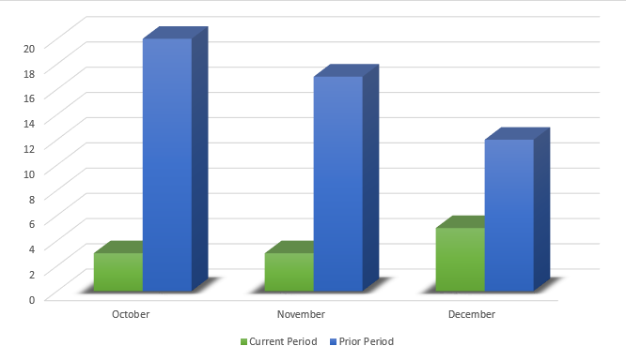
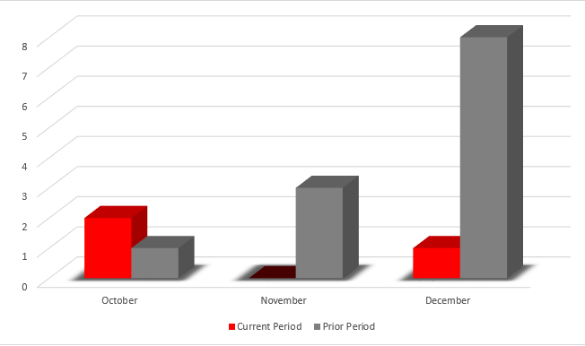
HTM Agents
Fourth Quarter 2020
New Policy Count
Policies in Force
Last Year
Cancelled Policy Count
Cameron, Karen and Scott
Notes:
In the past, I have been giving data on the Gunter Insurance portfolio due to the purchase. Now that we are over a year past the purchase and AVIVA rollover, I will now be reporting on the agents portfolio as a whole which includes Cameron, Scott and Karen. New policies for the month of July were 13, compared to 23 in 2019, 4 in August compared to 21 in 2019 and 2 in September compared to 25 in 2019. It is important to note that Cameron’s number are a little skewed as he still is writing new business under Pearson Insurance’s number (approximately half).
Cancellation were up slightly in 2020 compared to 2019 with 2 in July, 4 in August and 7 in September. Retention rate continues to be over 93% combined for all lines.
We have 646 policies in force, which is up 15.2% from last year.

Slide 57
HTM Agents
Fourth Quarter 2020
Premiums Written
Premiums Written
Last Year
Cameron, Karen and Scott
Notes:
Premiums written has increased by $121,789 compared to last year, the most significant amount was in auto with an increase of $82,676. Commercial increased by $6,405, residential by $13,169 and farm by $19,539.

Slide 58
HTM Agents
Fourth Quarter 2020
Claims Incurred
Claims Incurred
Last Year
Claims Count
Last Year
Gross Loss Ratio
Last Year
Cameron, Karen and Scott
Notes:
Claims for 2020 are down significantly from last year. Overall Cameron, Karen and Scott have a very loss ratio for 2020 with 18 claims in total. **More on claims to add

Slide 59
VP loss prevention report
Update To Dec 31

Slide 60
update
Inspectors off the road, waiting for the end of the lock down to re-evaluate
Returned to inspection review project
New tablets being set up and issued to the inspectors
Underwriting caught up on inspections

Slide 61
update
185 inspections performed in the 4th quarter
64 of those risks had recommendations

Slide 62
HTM Recommendation Breakdown – 2020 4th Quarter
Description
Building Information (e.g. Foundation cracks) |  |  |  | 5
Electrical |  |  |  | 25
Heating (inc outdoor furnace) |  |  |  | 10
Liability |  |  |  | 34
Life Safety |  |  |  | 15
Water (grading, downspouts etc.) |  |  |  | 10
Roofing |  |  |  | 6
Sump Pump/Plumbing |  |  |  | 8
Totals |  |  |  | 113

Slide 63
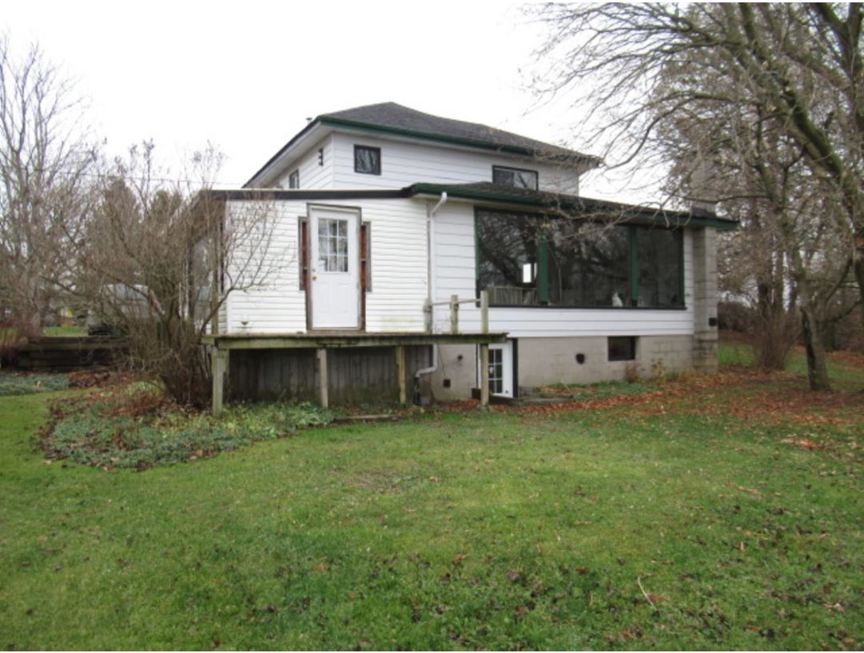

Slide 64
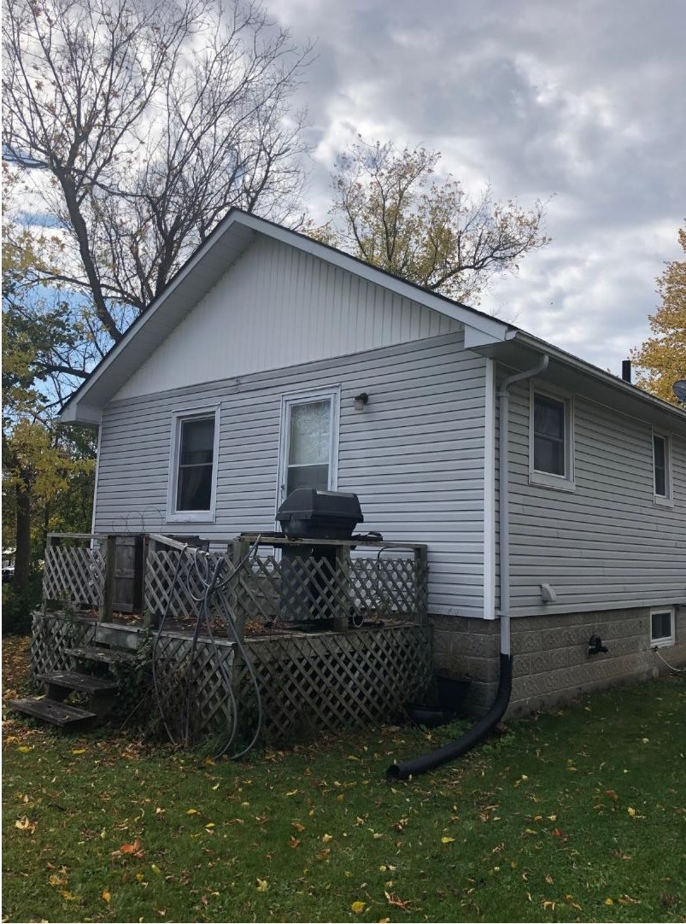

Slide 65
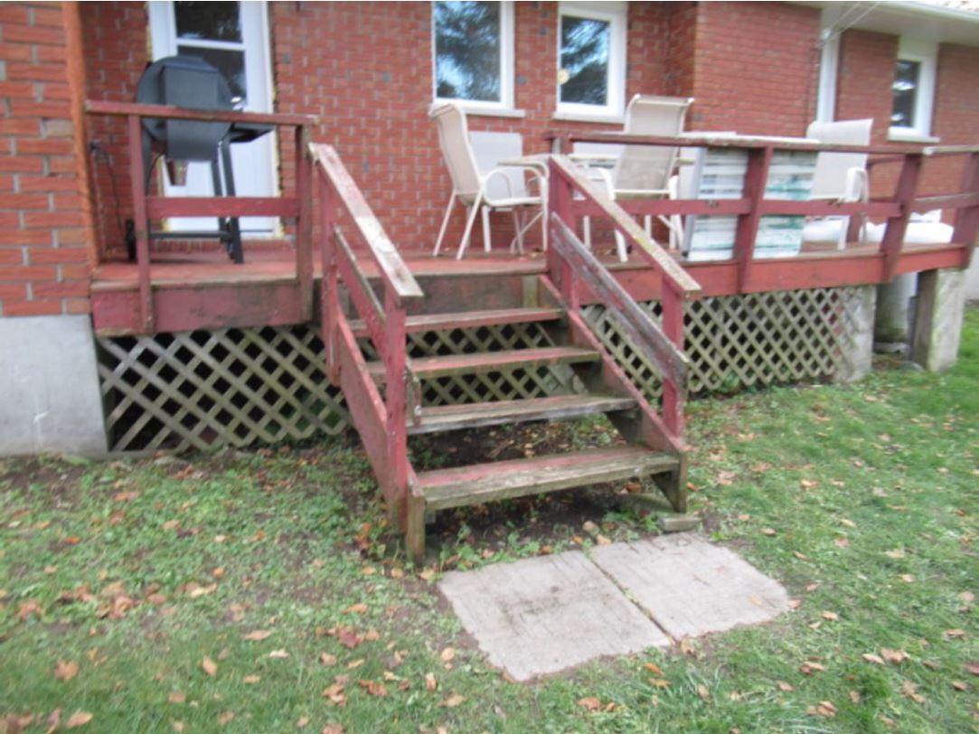

Slide 66
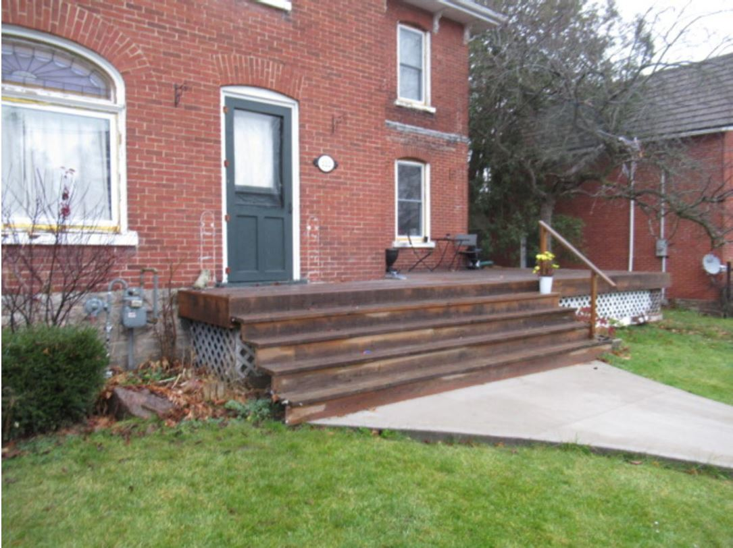

Slide 67
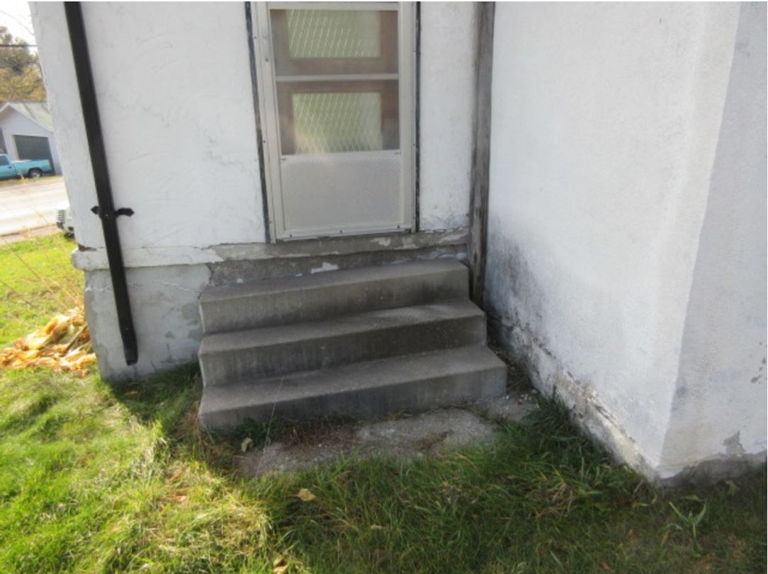

Slide 68
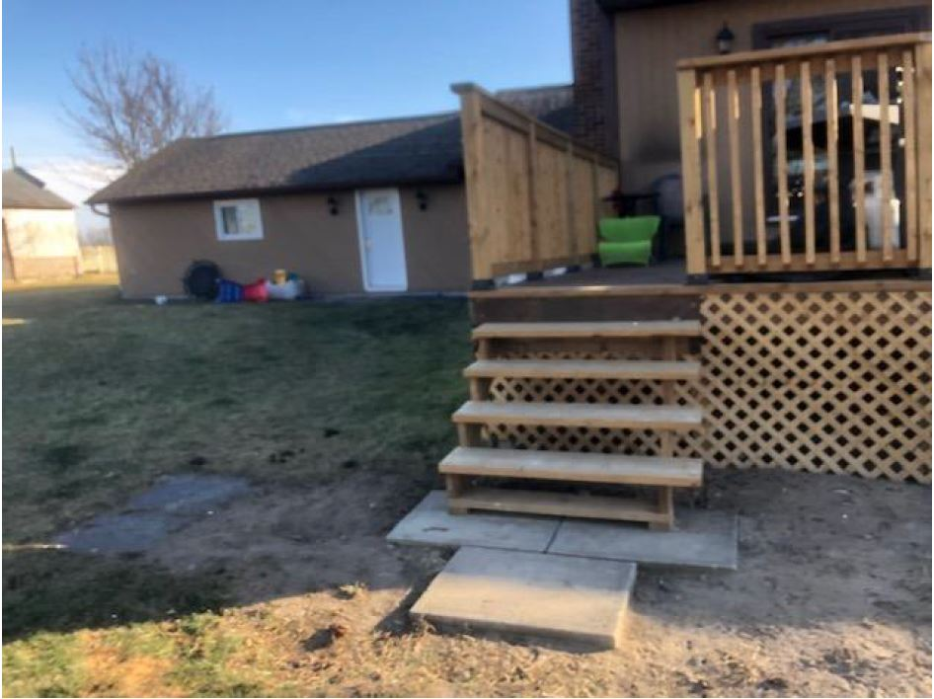

Slide 69
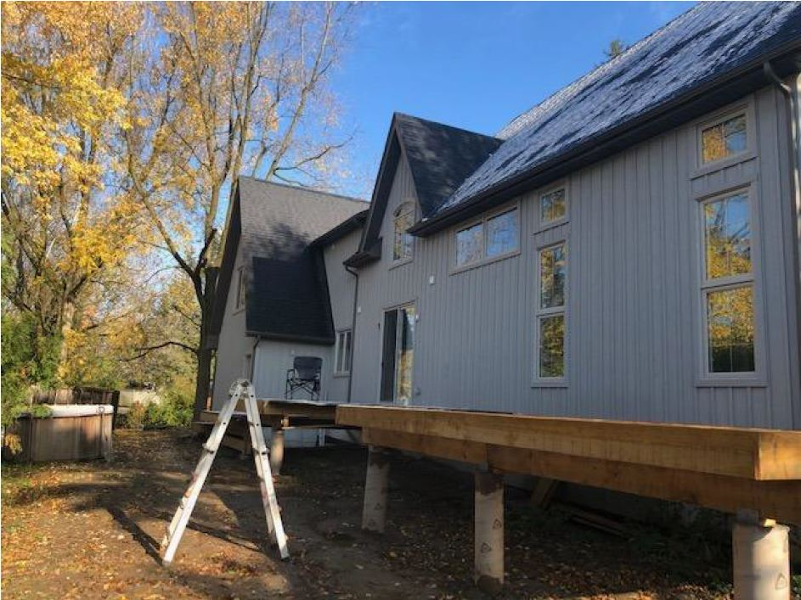

Slide 70
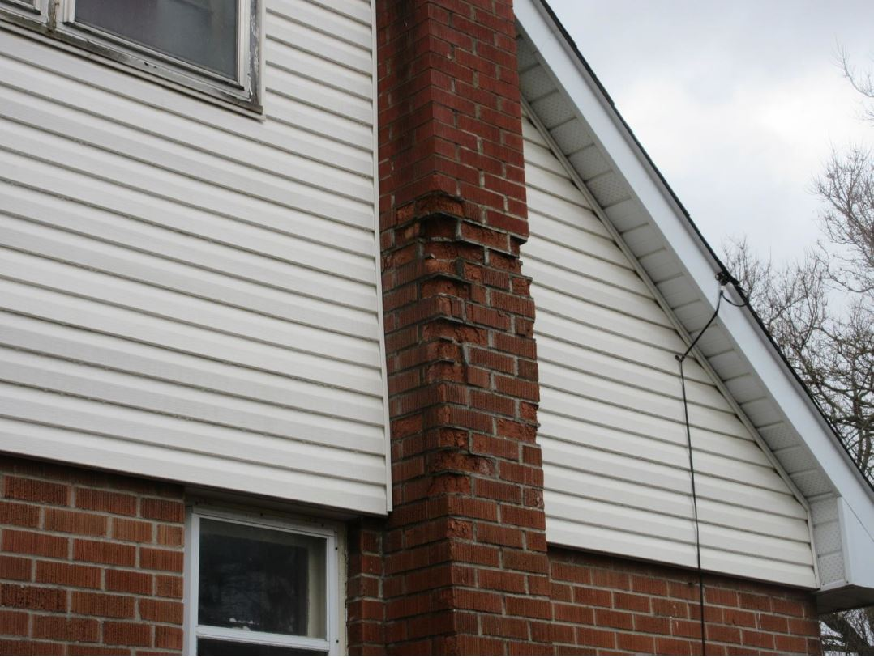

Slide 71
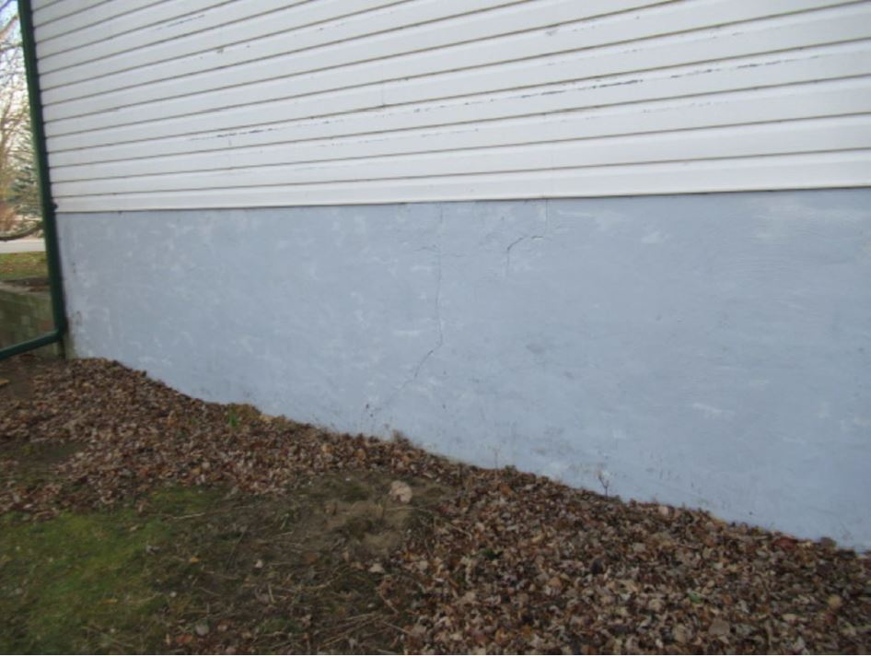

Slide 72
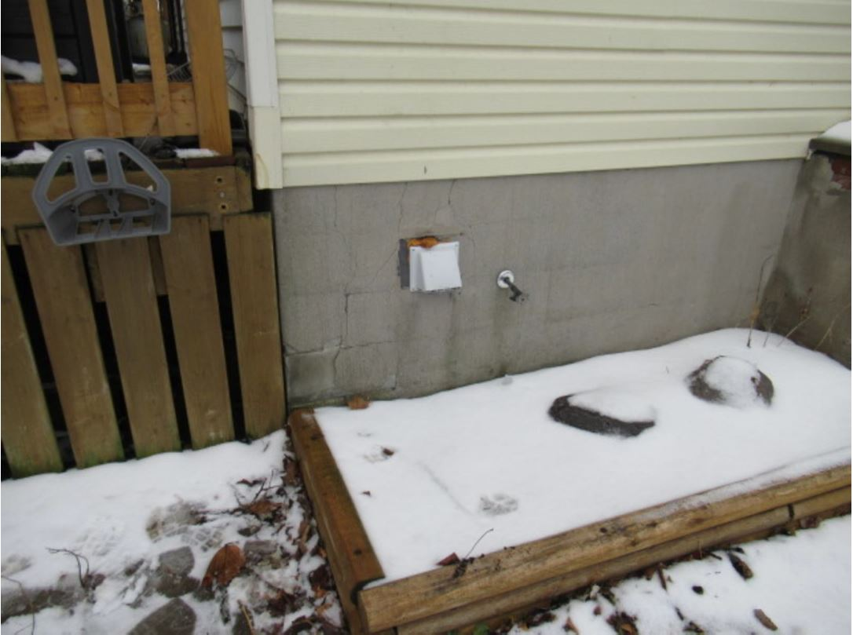

Slide 73
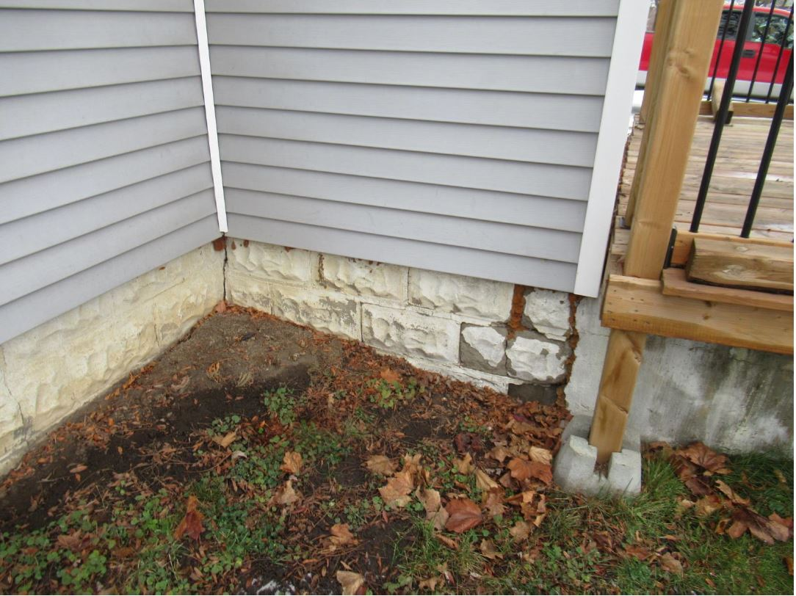

Slide 74
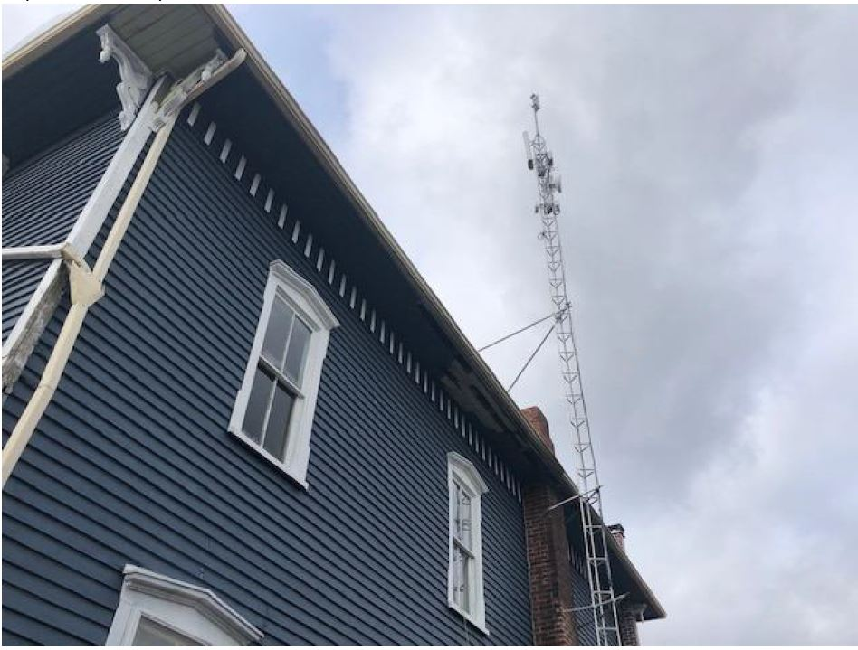

Slide 75
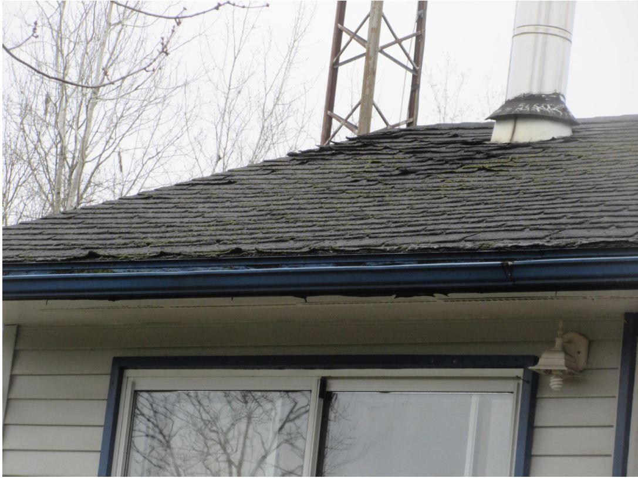

Slide 77
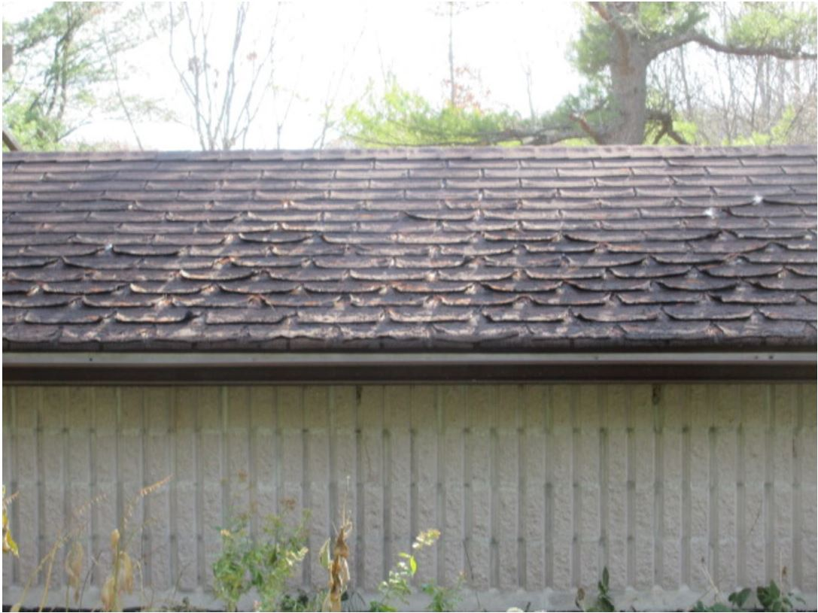

Slide 78
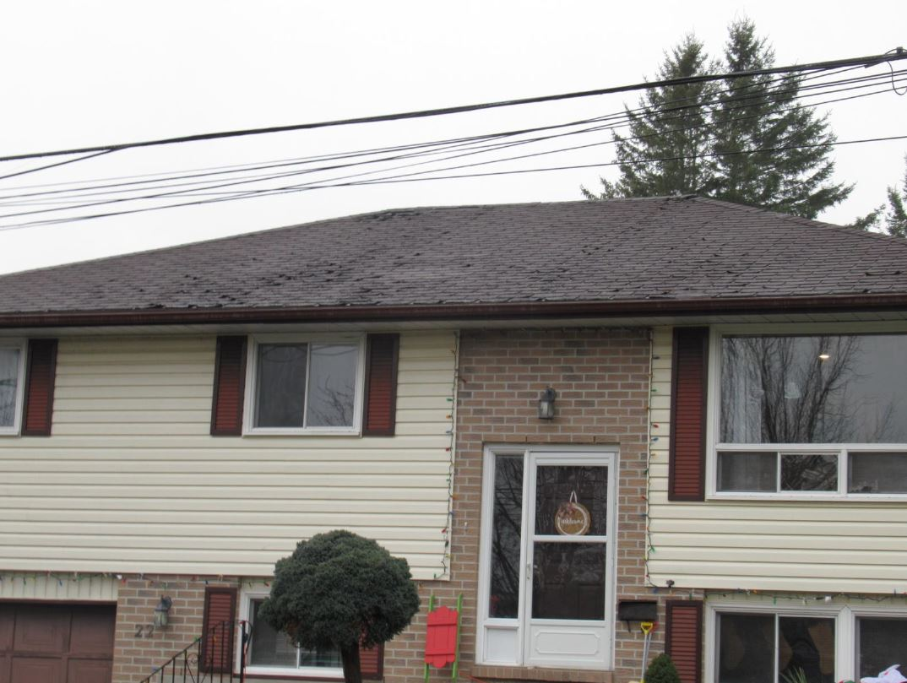

Slide 79
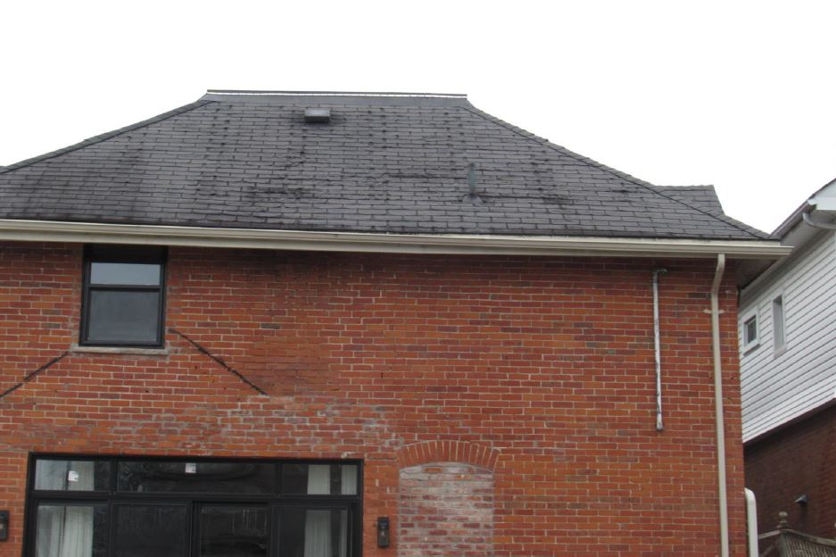

Slide 80
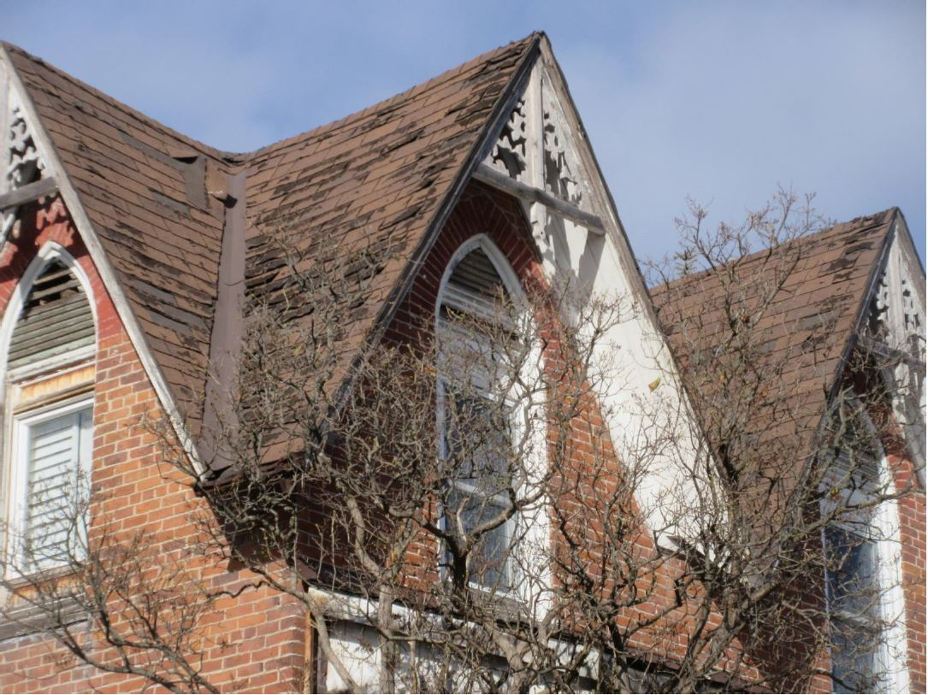

Slide 82
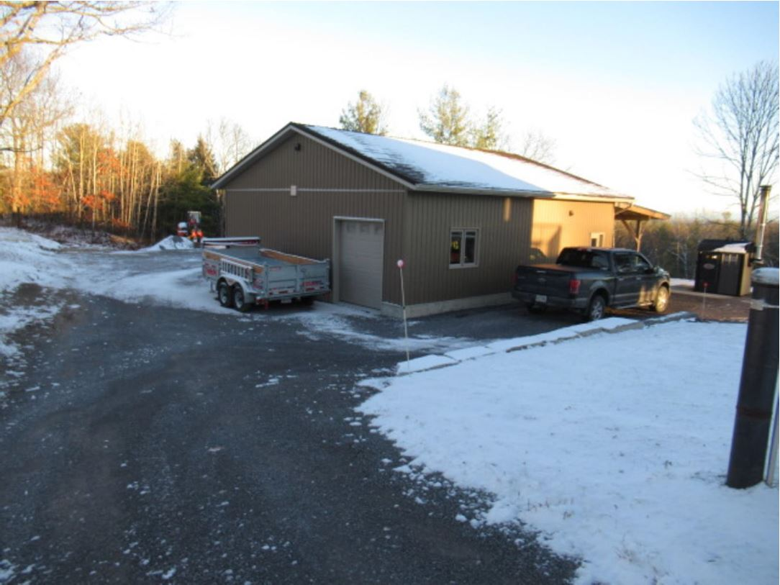

Slide 83
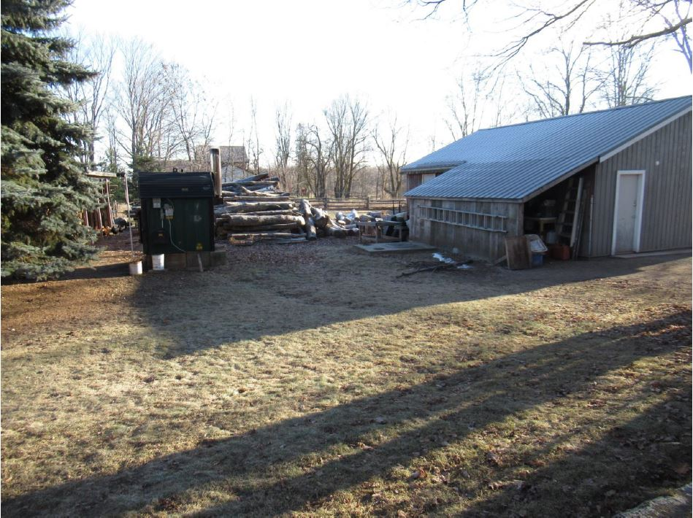

Slide 84
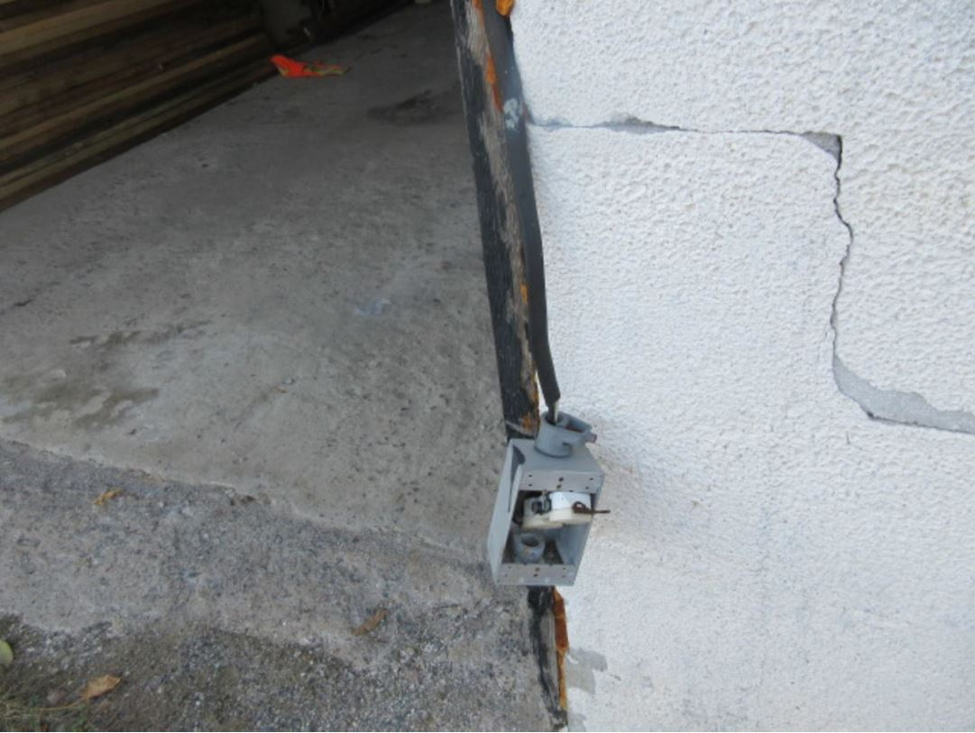

Slide 85
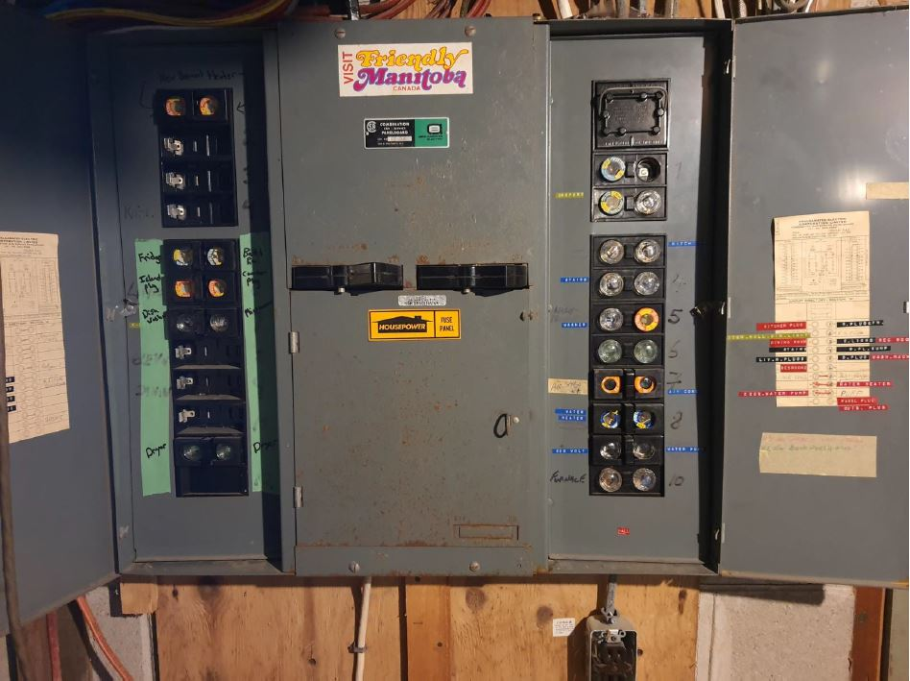

Slide 86
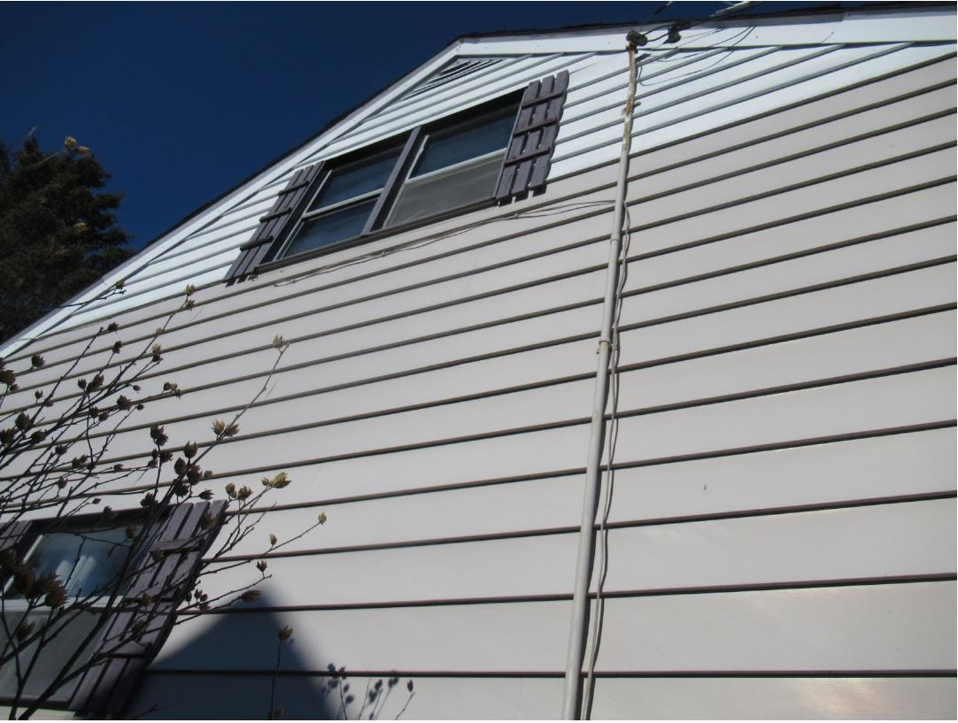

Slide 87
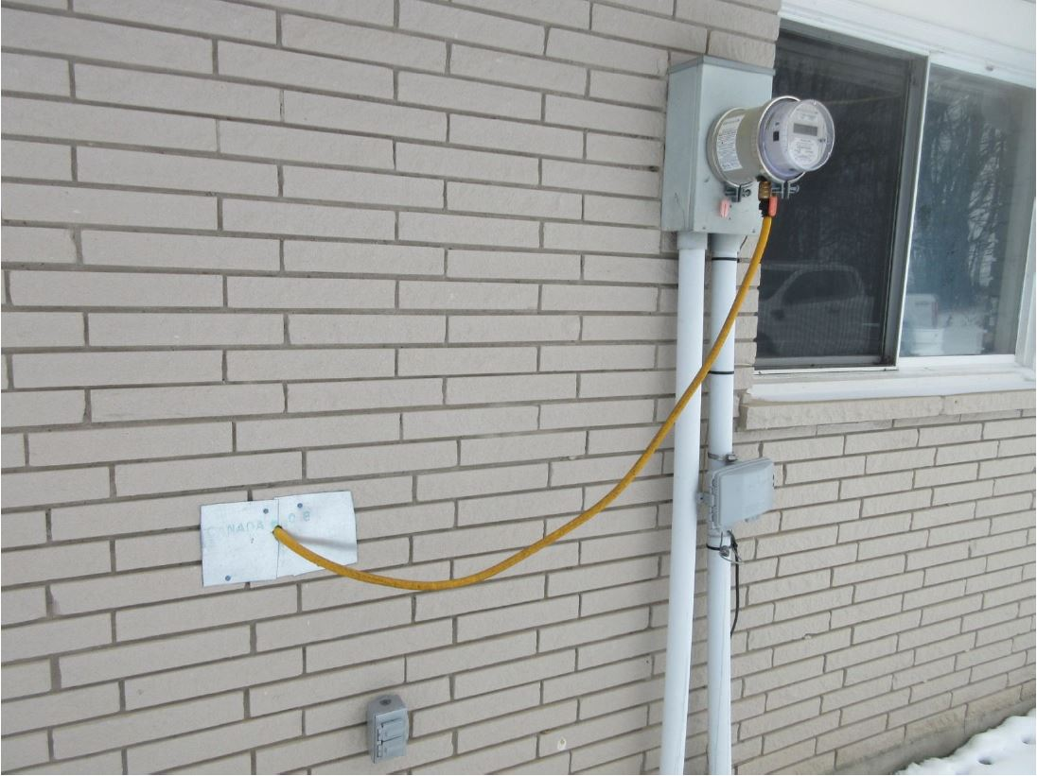

Slide 88
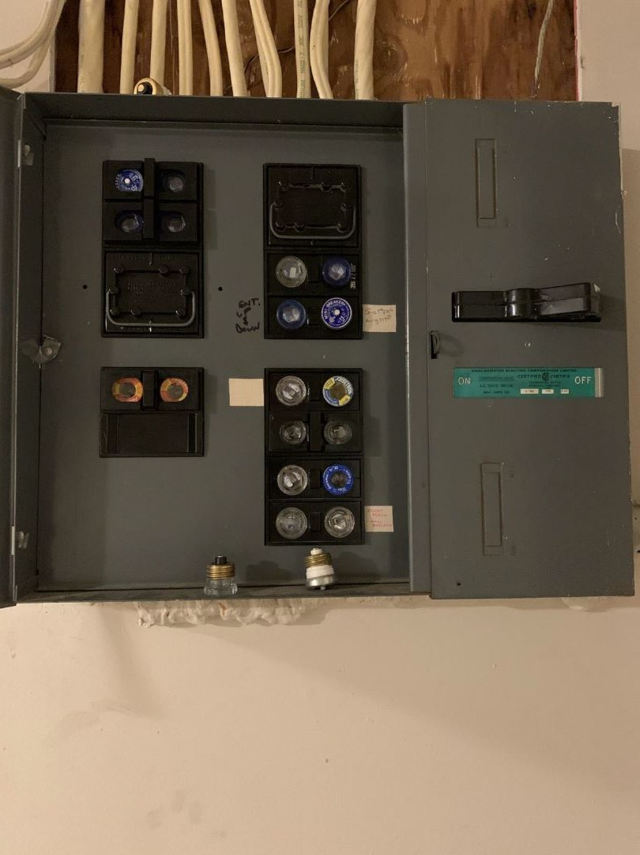

Slide 89
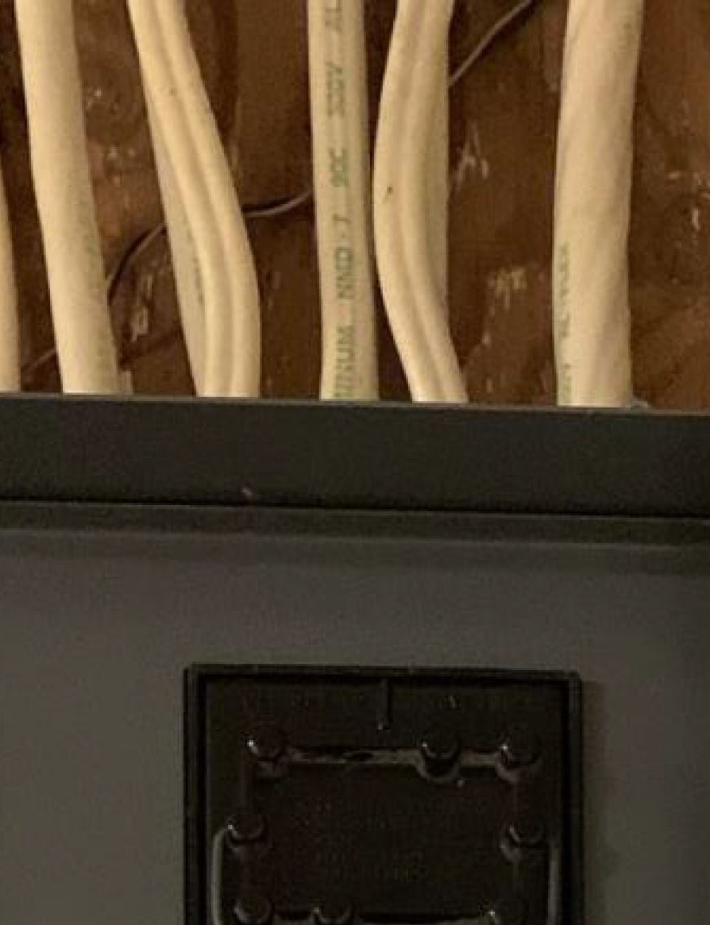

Slide 90
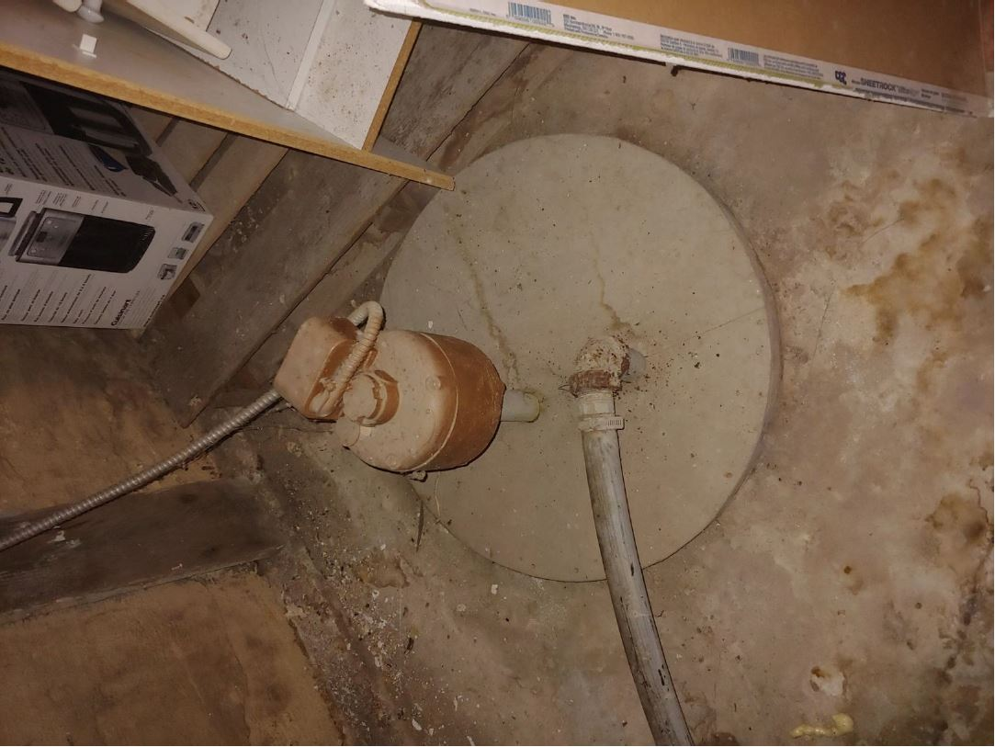

Slide 91
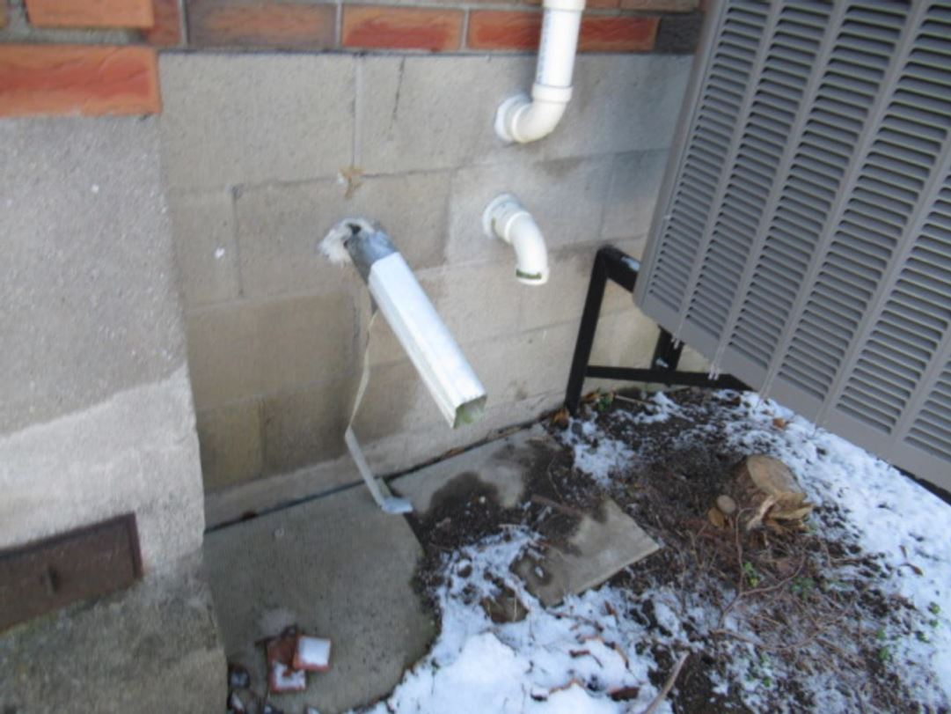

Slide 92
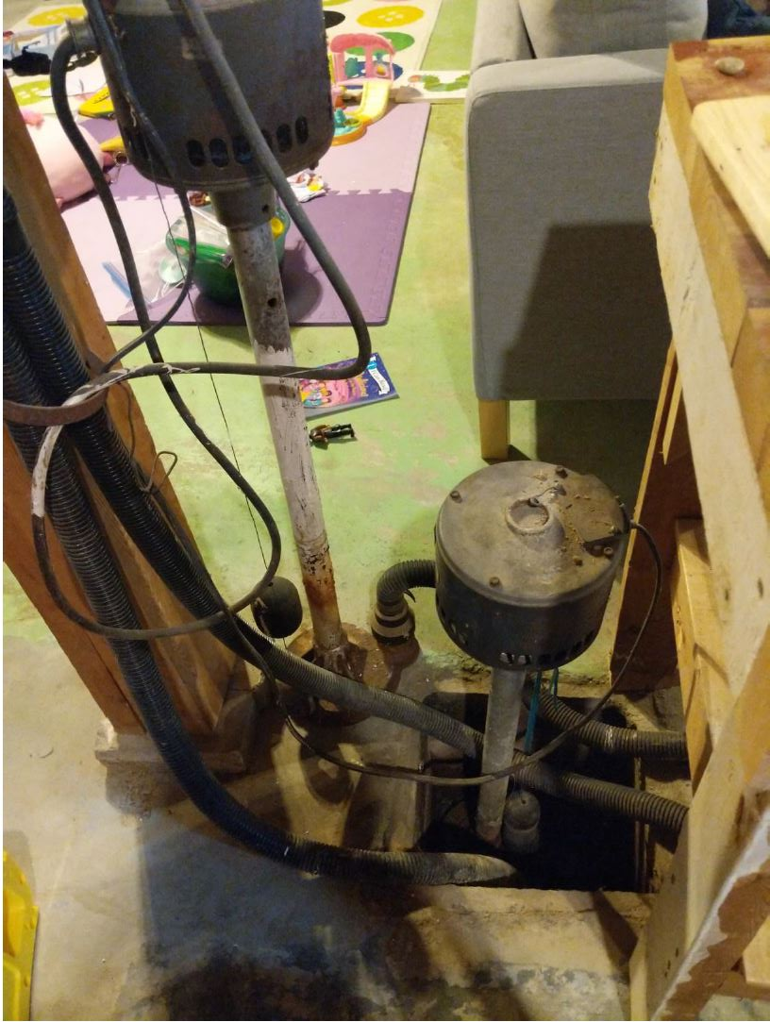

Slide 93
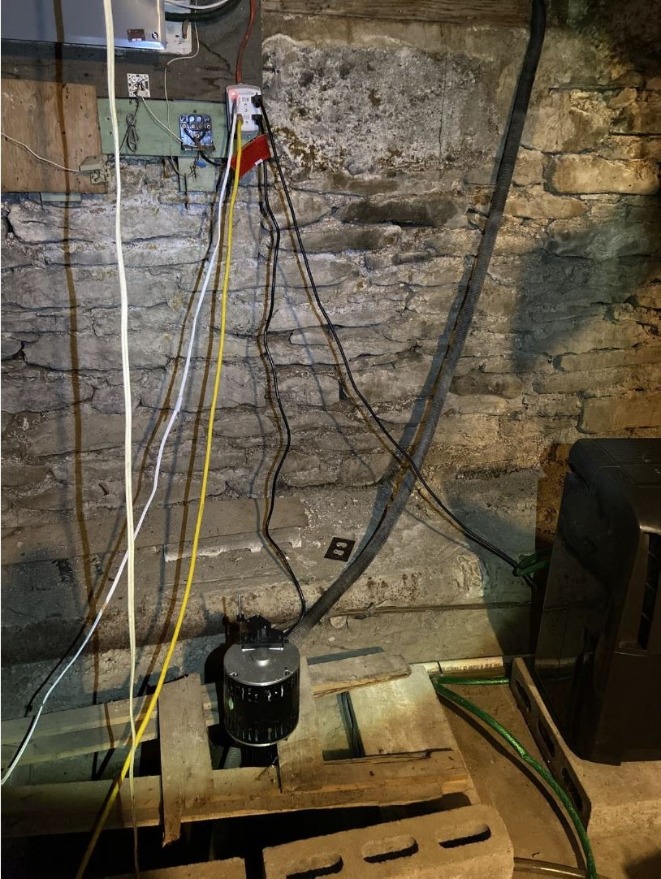

Slide 94
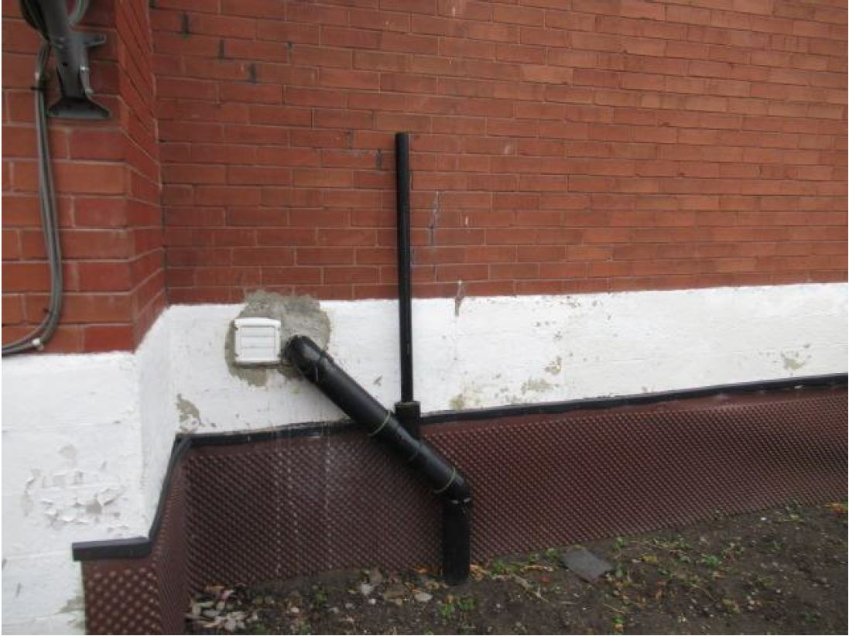

Slide 95
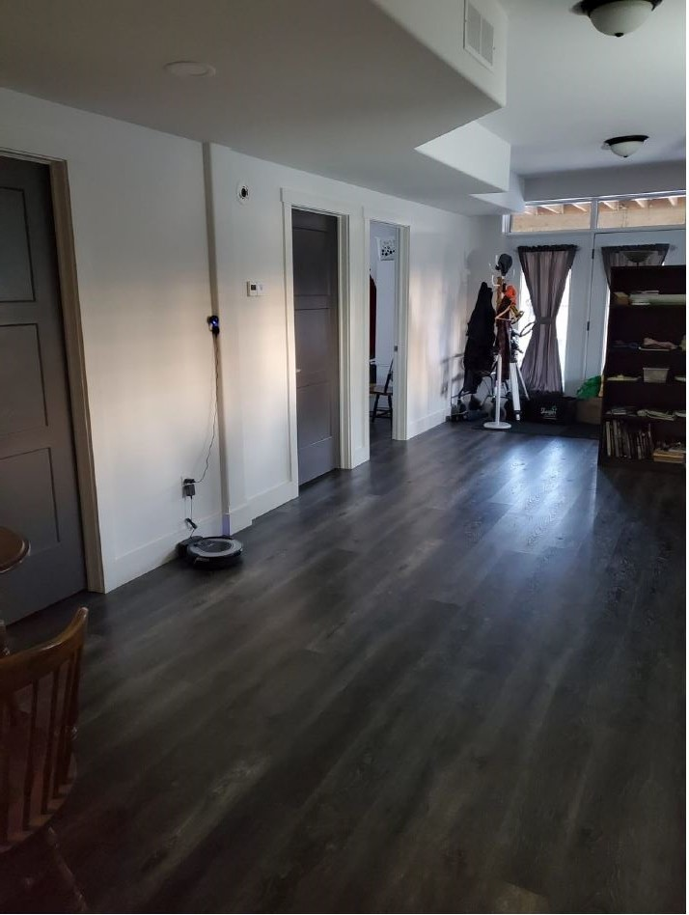

Slide 96
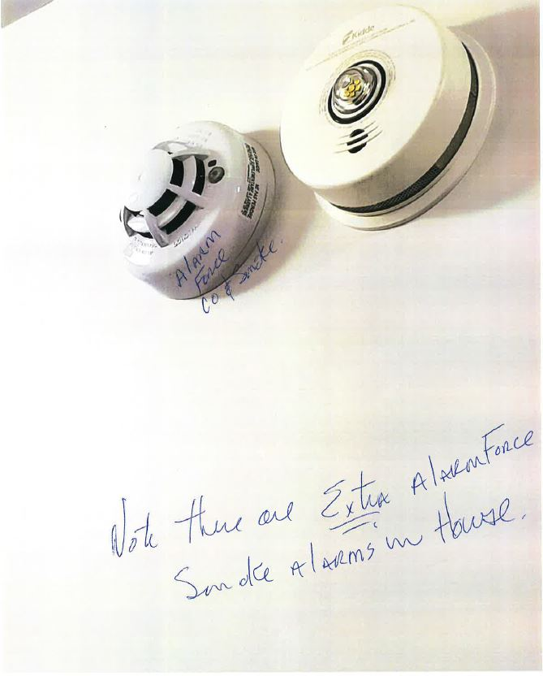

Slide 97
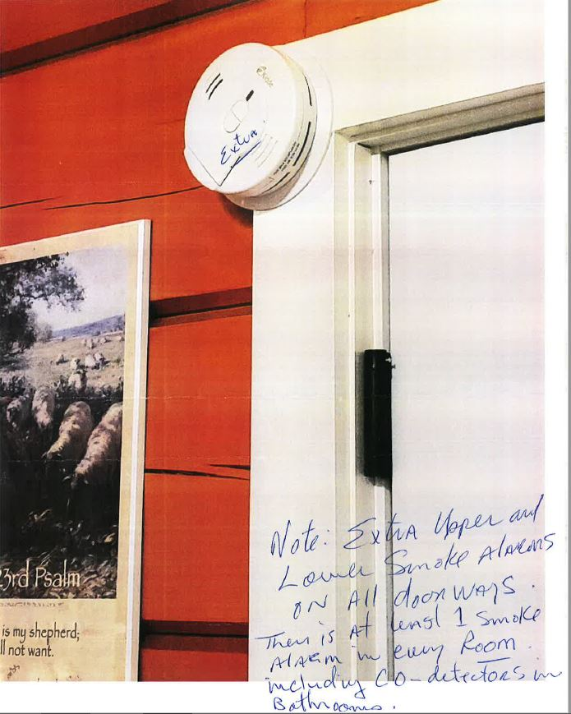

Slide 98
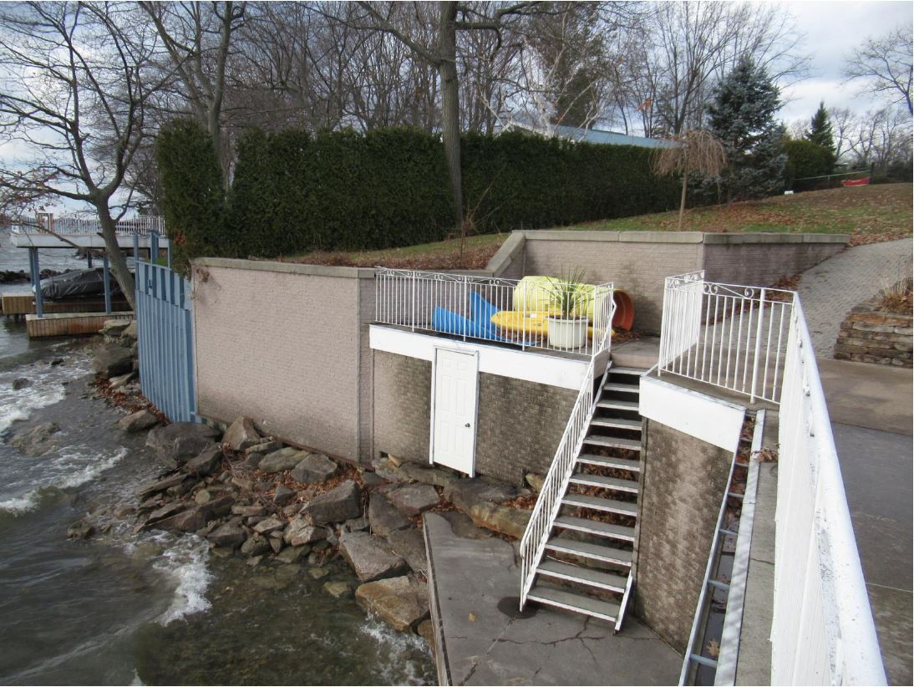

Slide 99
financial report
Update To Dec 31

Slide 100
update
Andrea Birney joined our department in December
Department has been busy with year end and responding to the auditors questions.
April and Jenn are both working hard on their accounting education.
Ryan and I are working on the plan for the new website.

Slide 101
January 2021 Estimate
Description | Estimate
Premium Volume | $2M (up 7.4%)
Underwriting Profit (Loss) | $300K
Net Profit (Loss) | TBD
Surplus | TBD
Income
Forecast

Slide 102
2020 financials
Final report for the year

Slide 103
Motion
“
To approve the audit committee report”
Moved by
Seconded by
Notes:
ALLAN: Now that we have reviewed all the materials. The following motion has been made. It is moved by Dave and seconded by Nancy, that Per Diems ….
ALLAN: Is there any discussion on the motion.
ALLAN: Could we have a show of those in favour by raising your virtual hand.
ALLAN:

Slide 104
Action items for 2021
Inter-department or cross-training

Slide 105
Cross-training
Project Manager: Bryce Clarke
Team Members: TBD
Purpose of the project: To promote a basic understanding of the inter-dependency between departments by providing cross-training opportunities for employees.
Status: Not started
Target Date: Cross training activities to start in April

Slide 106
Consumer portal
Project Manager: Christine Howe
Team Members: Scott H., Ryan, April, Allison, Alec
Purpose of the project: To assist Cognition+ in the design and implementation of a consumer portal through user testing and feedback with the ultimate goal of providing a digital experience for our policyholders, Agents and Brokers and providing the same opportunity for our fellow mutuals.
Status: Kick off meeting with Cognition+
Implementing the consumer portal using HTM’s test system
Initial User Training
Target Date: Going live in June

Slide 107
Human resources
Project Manager: Steve O’Connell
Team Members: Donna, others TBD
Purpose of the project: To work with Kirwin Group in implementing improvements to our Human Resource program through policy development, training and design.
Status: Kick off meeting with Heather (Kirwin), Donna and Alec
Development of a list comparing current state versus desired
Target Date: On-going development through 2021

Slide 108
Cognition+ implementations
Project Manager: Warren
Team Members: Barb, Alec, Some Farm/Commercial Underwriters
Purpose of the project: To assist Cognition+ in the design and implementation of Commercial and Agri-business area of the insurance system through user testing and feedback with the ultimate goal of moving all lines of business to the new platform and providing the same opportunity for our fellow mutuals.
Status: Several meetings since implementation on our Beta sight
User testing starting last week in Farm
User testing starting shortly in Commercial
Model Office testing in Farm beginning in April
Target Date: Live with Agri-business in May and Commercial in June

Slide 109
Compliance calendar
Project Manager: Barb
Team Members: Alec
Purpose of the project: To create a compliance calendar for use by the board in 2022 by identifying and documenting key governance and compliance issues during 2021, while at the same time looking for opportunities for improvement.
Status: January compliance issues identified
Reported to the board in February
Target Date: Initial compliance calendar available January 2022

Slide 110
Sales website
Project Manager: Christine Howe
Team Members: Ryan, others TBD
Purpose of the project: To investigate the benefits of having a “sales website” to assist our agents with attracting new policyholders and serving the current ones, and if deemed beneficial, to create the website.
Status: Not started
Target Date: August 2021

Slide 111
Website and central repository
Project Manager: Donna
Team Members: Ryan, others TBD
Purpose of the project: To review our current website software platform against others to see if a change is warranted. To investigate, create and implement a central repository for digital documentation that improves on accessibility, structure and search functionality.
Status: Not started
Target Date: Repository Q2, Website Q4

Slide 112
donations
Ideas for donations and revised budget for 2021

Slide 113
Motion
“
To approve a new budget of __ dollars for 2021”
Moved by
Seconded by
Notes:
ALLAN: Now that we have reviewed all the materials. The following motion has been made. It is moved by Dave and seconded by Nancy, that Per Diems ….
ALLAN: Is there any discussion on the motion.
ALLAN: Could we have a show of those in favour by raising your virtual hand.
ALLAN:

Slide 114
Conduct review committee (crc)
Report to the board for 2020

Slide 115
Motion
“
To accept the report of the Conduct review Committee for 2020”
Moved by
Seconded by
Notes:
ALLAN: Now that we have reviewed all the materials. The following motion has been made. It is moved by Dave and seconded by Nancy, that Per Diems ….
ALLAN: Is there any discussion on the motion.
ALLAN: Could we have a show of those in favour by raising your virtual hand.
ALLAN:

Slide 116
Other business
List of final items

Slide 117
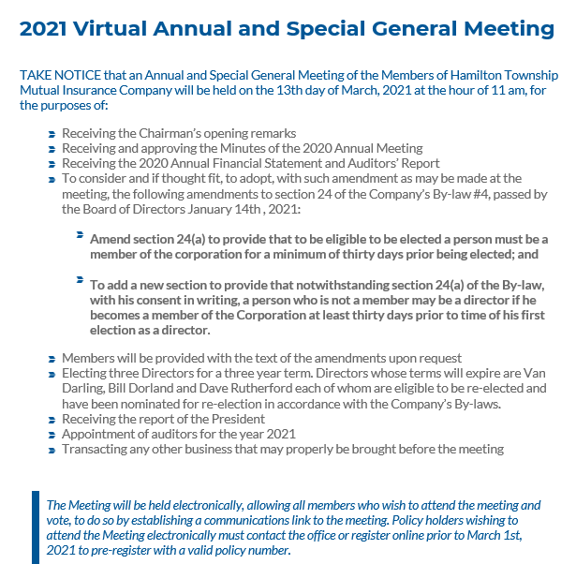
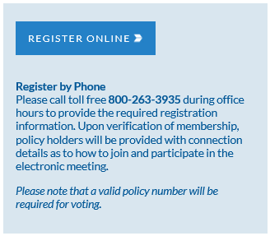
Virtual annual meeting

Slide 118
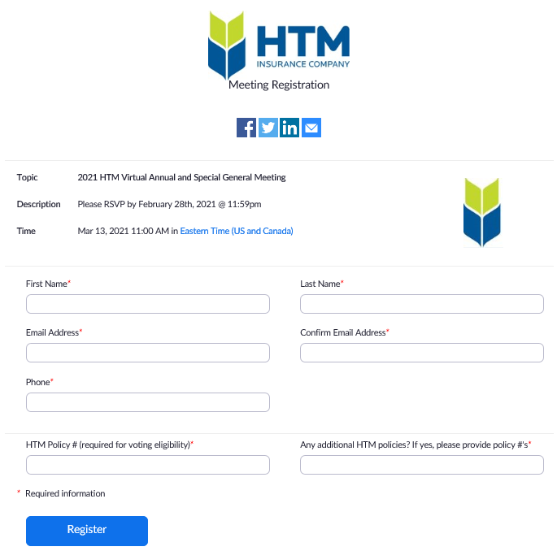
Virtual annual meeting

Slide 119
adjourn

Slide 120
Thank You

